Slide 1
Bookbinders Book Club Case
Database Marketing
Behavioral (Micro) Targeting ➔ Predictive Modeling
RFM Model
Regression model
Gain Charts (also called Lift Charts)
Choice Model (Logit Model) (TN03 - Choice Modeling (enginius.biz))
Please note: Chapter 2 and Chapter 3 have related sections.
Notes:
For Instructor access only https://www.enginius.biz/index.php/case_studies/bookbinders-case-study-predictive/
It is available for all at https://www.youtube.com/watch?v=u7FWUlWmCDY
https://www.youtube.com/watch?v=u7FWUlWmCDY

Slide 2
Background
Stylized case based on real problems faced by a real direct marketing company that located in Eastern USA.
Case set in the 1990's but the analytics used are applicable in many contemporary contexts.
Data available for analysis are the results of a test mailing to a random sample of its customers to promote a new book, The Art History of Florence.
The case ask students to answer essentially the following two questions:
  Develop an individual-targeting plan (i.e., who to mail to) that optimizes profits from a mail campaign, and
  Recommend the analytical model(s) the company should use in the future.

Slide 3
Data Sets
The datasets includes the following fields for each customer:
Gender
Amount purchased
Months since first purchase
Months since last purchase
Frequency of purchase
Past purchases of art books
Past purchases of children's books
Past purchases of cook books
Past purchases of DIY books
Past purchases of youth books

Slide 4
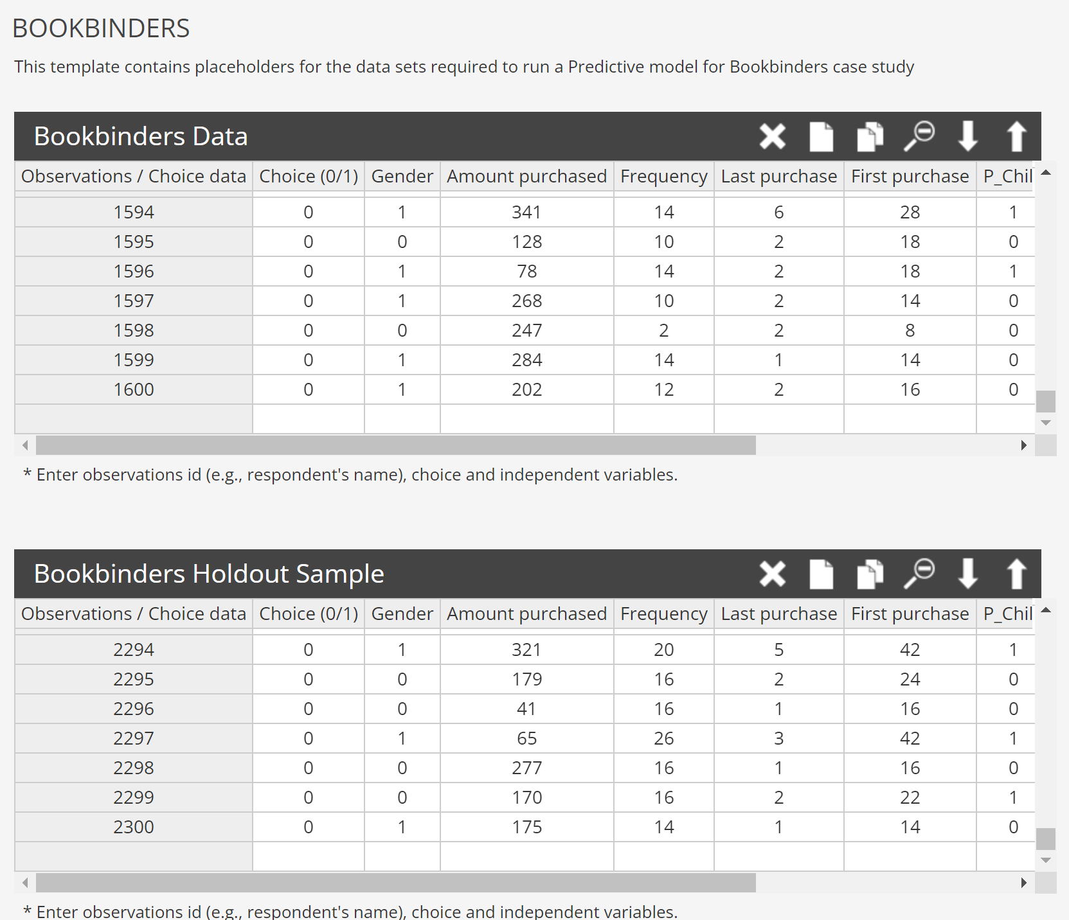
Data Sets in Enginius
Build the model
Training Data Set
Test the model
Validation Data Set

Slide 5
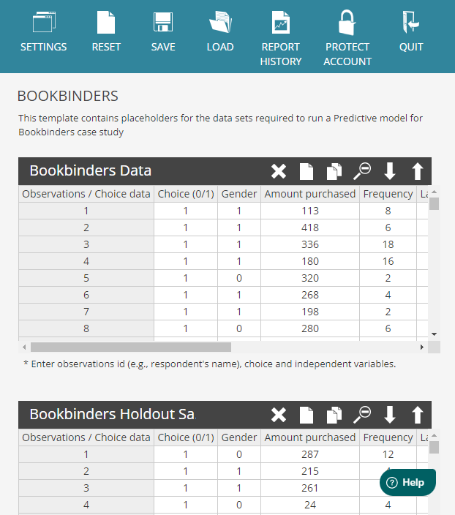
Download the datasets as Excel files
You may download the two datasets by clicking SAVE icon.
The download contains both Training dataset (1600 data points) and Holdout Sample dataset (2300 data points) in the same worksheet. You need to scroll down to see the second dataset.

Slide 6
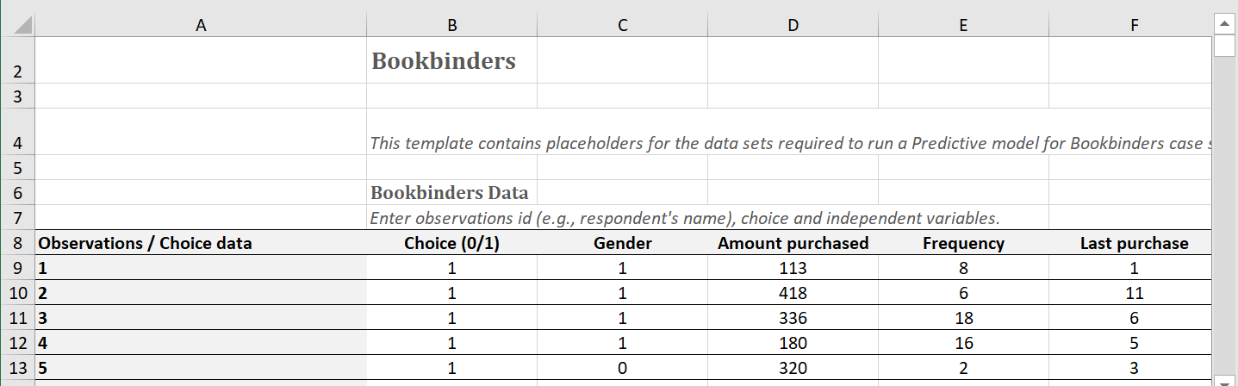
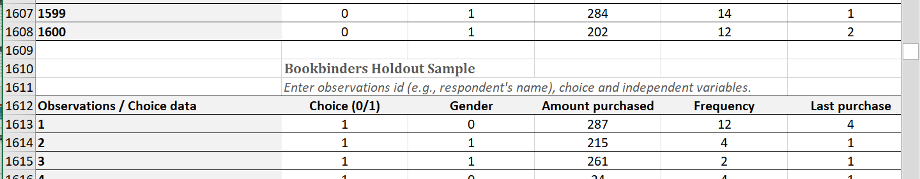
Training Dataset(1600)
Testing Dataset(2300)

Slide 7
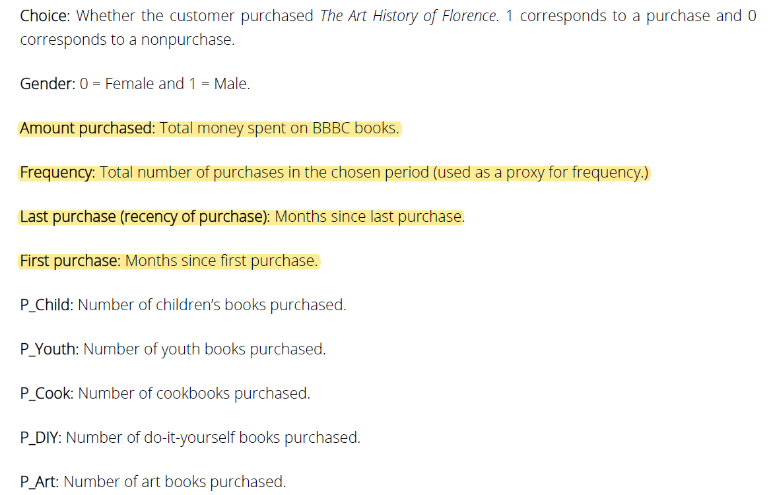

Slide 8
Predictive Models for Targeting Individual Customers
Steps | Tasks
1 | Create database of customer responses (choices) based either on test mailing to a sample of prospects/customers, or historical data of past customer purchases. ➔ Build the model??
2 | Use models such as Regression, RFM, and Logit to assess the impact of independent variables (drivers) of customer response.
3 | Score each customer/prospect based on the drivers identified in Step 2 - the higher the score, the more likely is the predicted response.
4 | Sort customers by their scores in Step 3. Classify customers into deciles (groups of equal size) based on their scores.
5 | Based on profitability analyses, determine the top deciles to which a marketing action (e.g., mailing of brochure) will be targeted.

Slide 9
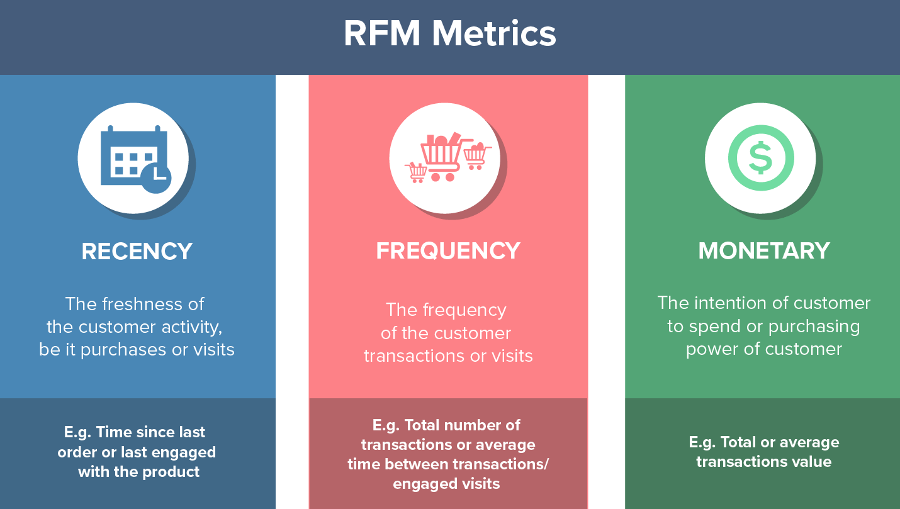
https://wiki.mbalib.com/zh-tw/RFM模型
https://en.wikipedia.org/wiki/RFM_(market_research)
The more recent the purchase, the more responsive the customer is to promotions
The more frequently the customer buys, the more engaged and satisfied they are
Monetary value differentiates heavy spenders from low-value purchasers
** See also examples at https://clevertap.com/blog/rfm-analysis/

Slide 10
Step-2 Example RFM Model Scoring Criteria
R | Months from last purchase | 13-max | 10-12 | 7-9 | 3-6 | 0-2
 | Score | 5pts | 10 | 15 | 20 | 25
F | Frequency | > 30 | 21-30 | 16-20 | 11-15 | 0-10
 | Score | 5pts | 10 | 15 | 20 | 25
M | Amount purchased | > 400 | 301-400 | 201-300 | 101- 200 | ≤ 100
 | Score | 50 | 45 | 30 | 15 | 10
Implement using Nested If statements in Excel
F scoring rule
The less frequent buyers the more likely they will purchase. ??
This offering is intended to "Keep" the customers.
It is assuming that people who purchase more recently are more likely to purchase again, thus higher score.
However, it is possible to score Recency another way assuming people who purchase some goods more recently, particular durable goods, may have a lower probability to purchase it again.
Notes:
Variables that represent recency, frequency, and monetary value are the following:
Recency: Months since last purchase (Last_purchase)
Frequency: Total number of purchase (Frequency)
Monetary value: Total money spent on BBBC (Amoun_purchased)

Slide 11
Scoring Rules for the R in RFM
Last purchased in the past 3 months 25 points
Last purchased in the past 4–7 months 20
Last purchased in the past 8-10 months 15
Last purchased in the 11-12 months 10
Last purchased in the past 13 months or more months 5
R at R6 formula ➔ =IF((E6 > 12),5,IF((E6>10),10,IF((E6 > 7),15,IF((E6>3),20,IF((E6<=3),25,0)))))
Use Lookup table instead of nested if statement

Slide 12
Example: RFM Model Scoring Criteria
Step 2
RFM model scoring rules is implemented in Nested If statements in Excel
R at R6 ➔ =IF((E6 > 12),5,IF((E6>10),10,IF((E6 > 7),15,IF((E6>3),20,IF((E6<=3),25,0)))))
F at Q6 ➔ IF((D6 > 30),5,IF((D6>20),10,IF((D6 > 15),15,IF((D6>10),20,IF((D6<=10),25,0)))))
M at P6 ➔ =IF((C6 > 400),50,IF((C6>300),45,IF((C6 > 200),30,IF((C6>100),15,IF((C6<=100),10,0)))))
For frequency F, Using the first data point at D6 transforms to Q6 based on scoring rule.
R | Months from last purchase | 13-max | 11-12 | 8-10 | 4-7 | 0-3
 | Max Score = 25 | 5 | 10 | 15 | 20 | 25
F | Frequency | > 30 | 21-30 | 16-20 | 11-15 | 0-10
 | Max Score = 25 | 5 | 10 | 15 | 20 | 25
M | Amount purchased | > 400 | 301-400 | 201-300 | 101-200 | ≤ 100
 | Max Score = 50 | 50 | 45 | 30 | 15 | 10
MKTG 521- Spring 2016 - 12

Slide 13
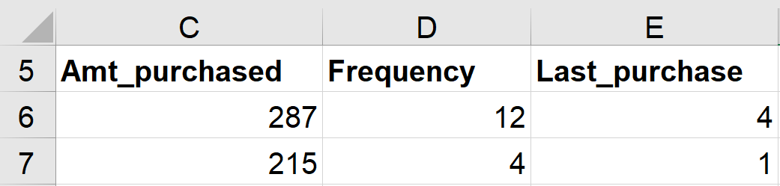
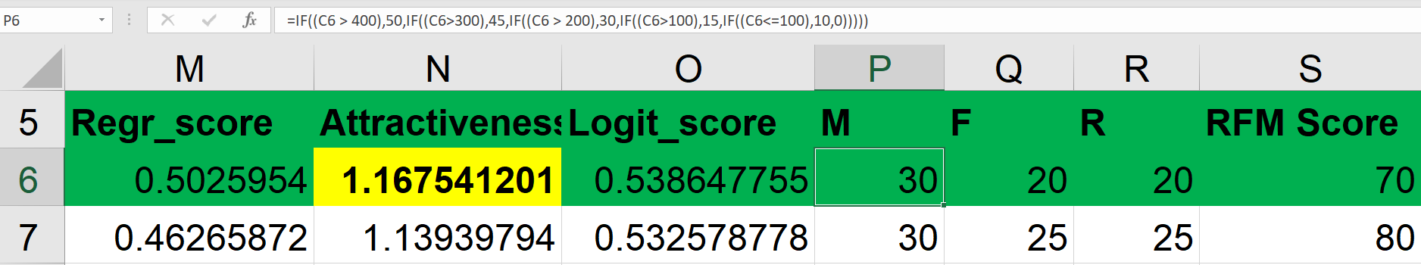
RFM Scoring
M at P6 formula ➔ =IF((C6 > 400),50,IF((C6>300),45,IF((C6 > 200),30,IF((C6>100),15,IF((C6<=100),10,0)))))
F at Q6 formula ➔ IF((D6 > 30),5,IF((D6>20),10,IF((D6 > 15),15,IF((D6>10),20,IF((D6<=10),25,0)))))?
R at R6 formula ➔ =IF((E6 > 12),5,IF((E6>10),10,IF((E6 > 7),15,IF((E6>3),20,IF((E6<=3),25,0)))))

Slide 14
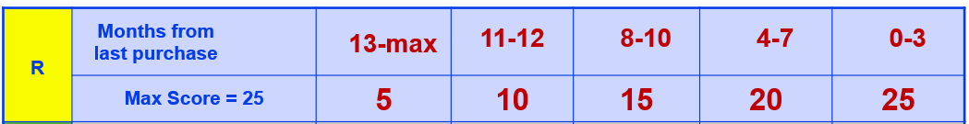
Use Excel Lookup Table Function to Determine the Score
RFM Scoring Table
R | Score
0 | 25
4 | 20
8 | 15
11 | 10
12 | 5
R at E6 formula ➔
=IF((E6 > 12),5,IF((E6>10),10,IF((E6 > 7),15,IF((E6>3),20,IF((E6<=3),25,0)))))
=VLOOKUP(E6, R_Scoring_Table, 2)
R_Scoring_Table
https://exceljet.net/lessons/how-to-replace-nested-ifs-with-vlookup

Slide 15
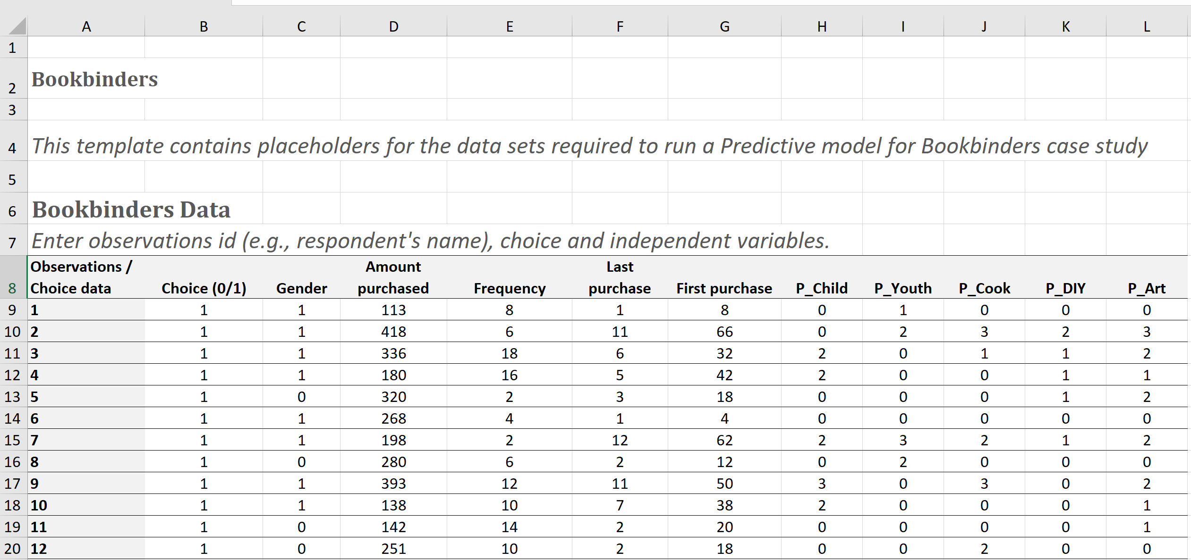
Data Set in Excel
Training Dataset size = 1600 with 400 choice = 1
Testing Dataset size = 2300 with 204 choice = 1

Slide 16
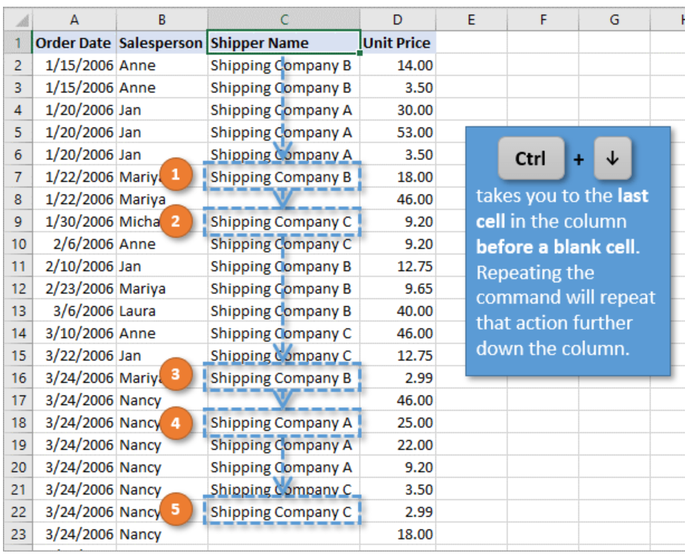
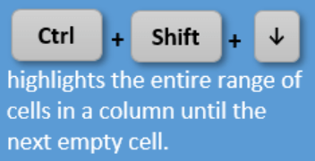
Keyboard Shortcuts for Selecting Cells and Ranges in Excel
Using Ctrl+Home takes you to the first visible cell on the sheet.
To add cells to the selected range: Shift+Arrow Key
https://www.excelcampus.com/keyboard-shortcuts/select-cells-ranges/

Slide 17
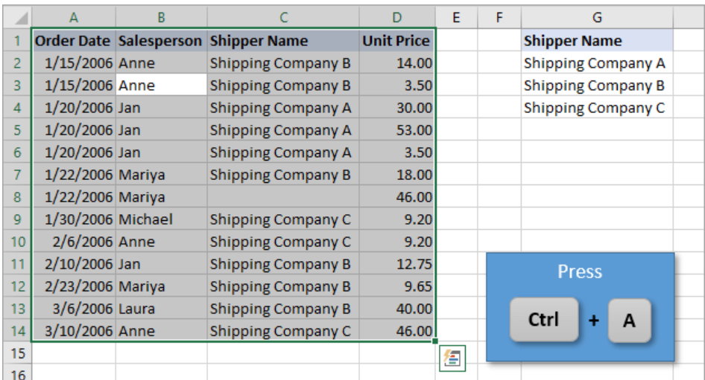
Select the Whole Range
The keyboard shortcut to select all cells in the current used range is: Ctrl+A
Press Ctrl+A a second time to select all cells on the sheet.
https://www.excelcampus.com/keyboard-shortcuts/select-cells-ranges/

Slide 18

Simple & Multiple Linear Regression and Logit Regression
Simple Linear Regression
y = b₀ + b₁ * X₁
_{Multiple Linear Regression}
y = b₀ + b₁ * X₁ + b₂ * X₂ + … b_{n} * X_{n}
The Logistic Regression ➔ for binary classification
L of a probability p when user responded (0 ≤ p ≤ 1) is defined as L=ln(p/(1−p))
The term (p/(1−p)) is called odds. The natural logarithm of the odds is known as log-odds or logit.
p =1/(1+e^{−L})
b_{i} is a coefficient
x_{i} an independent variable

Slide 19
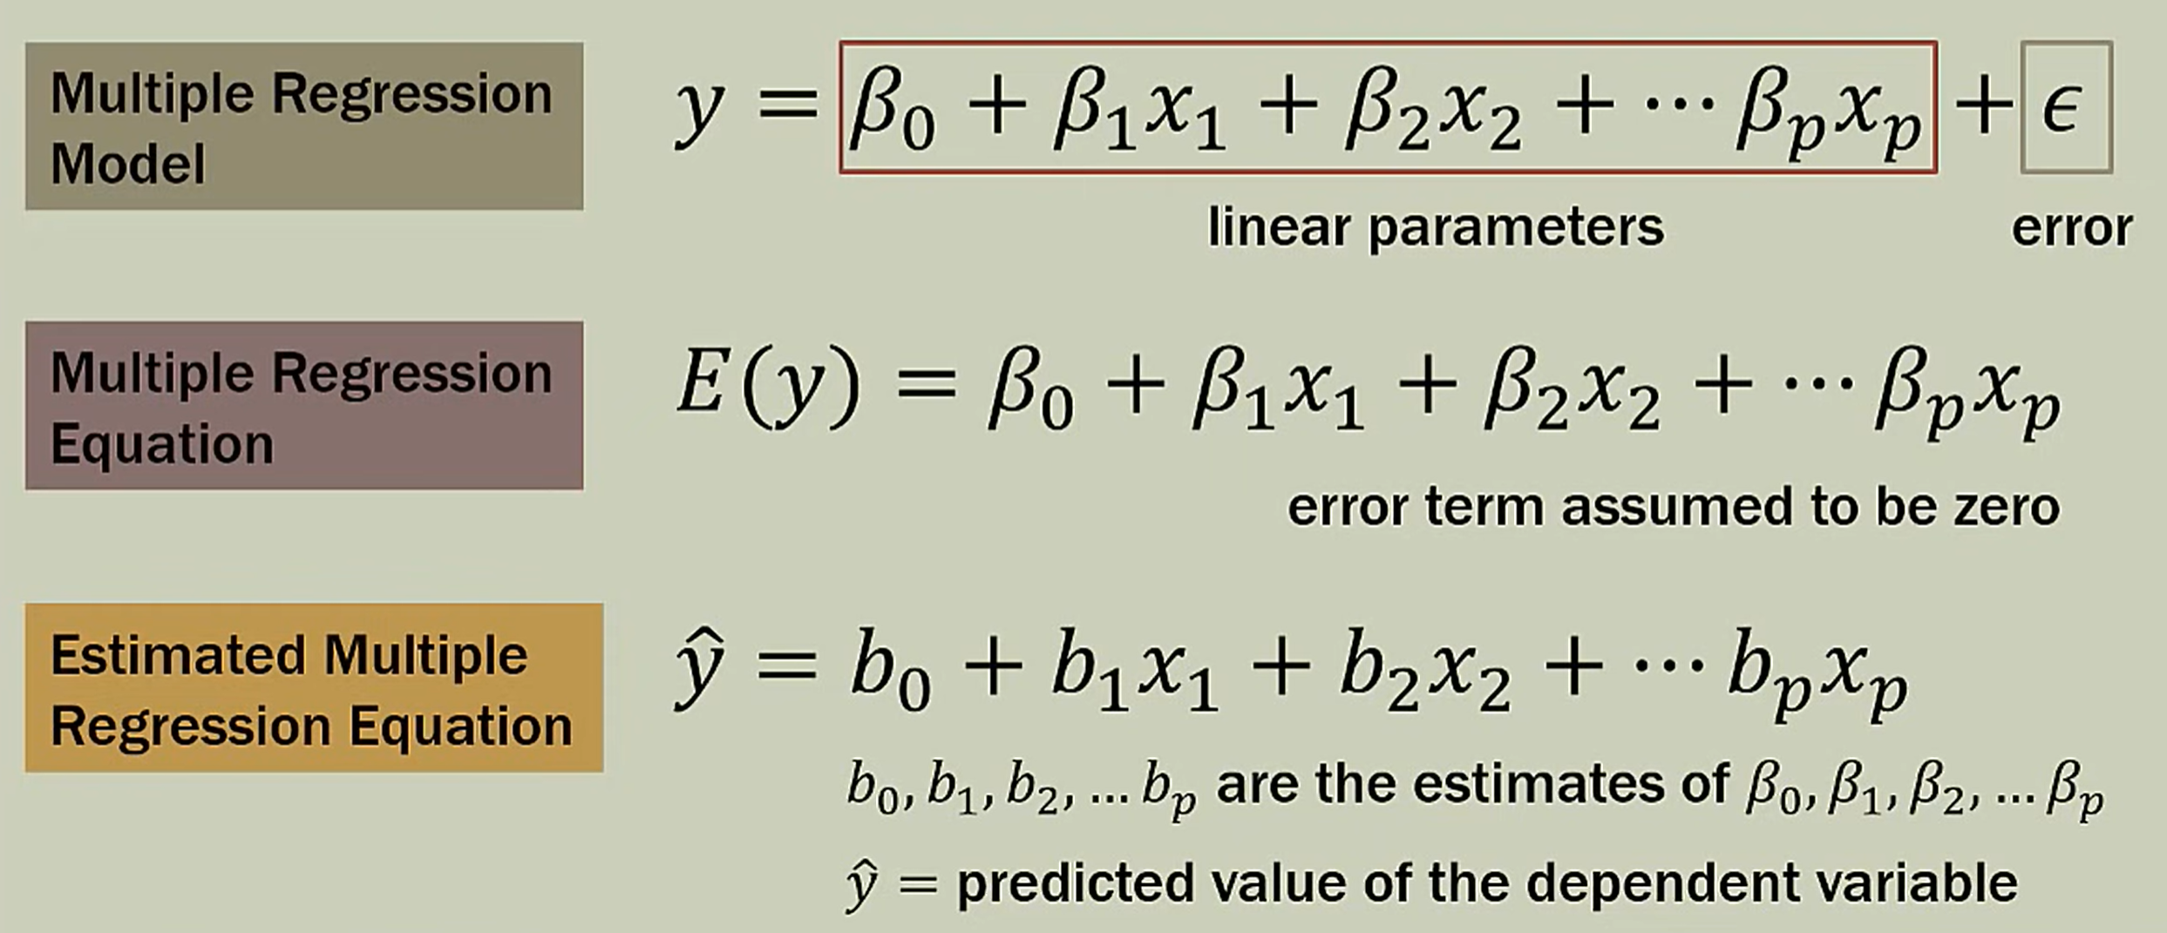
Linear Regression
Independent Variable (IV)自变量 Dependent Variables (DV)因变量
Coefficients

Slide 20
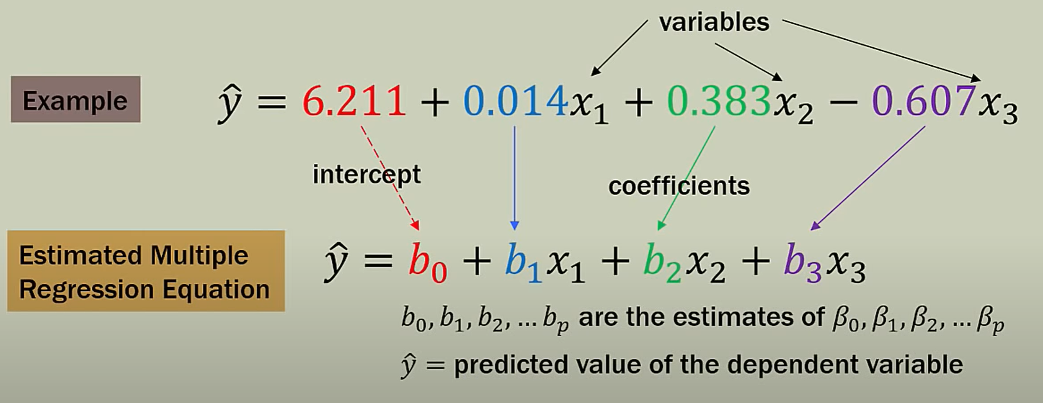
Make Predictions Using Estimated Multiple Linear Regression Equation
Statistics 101: Multiple Linear Regression, The Very Basics 📈 - YouTube

Slide 21
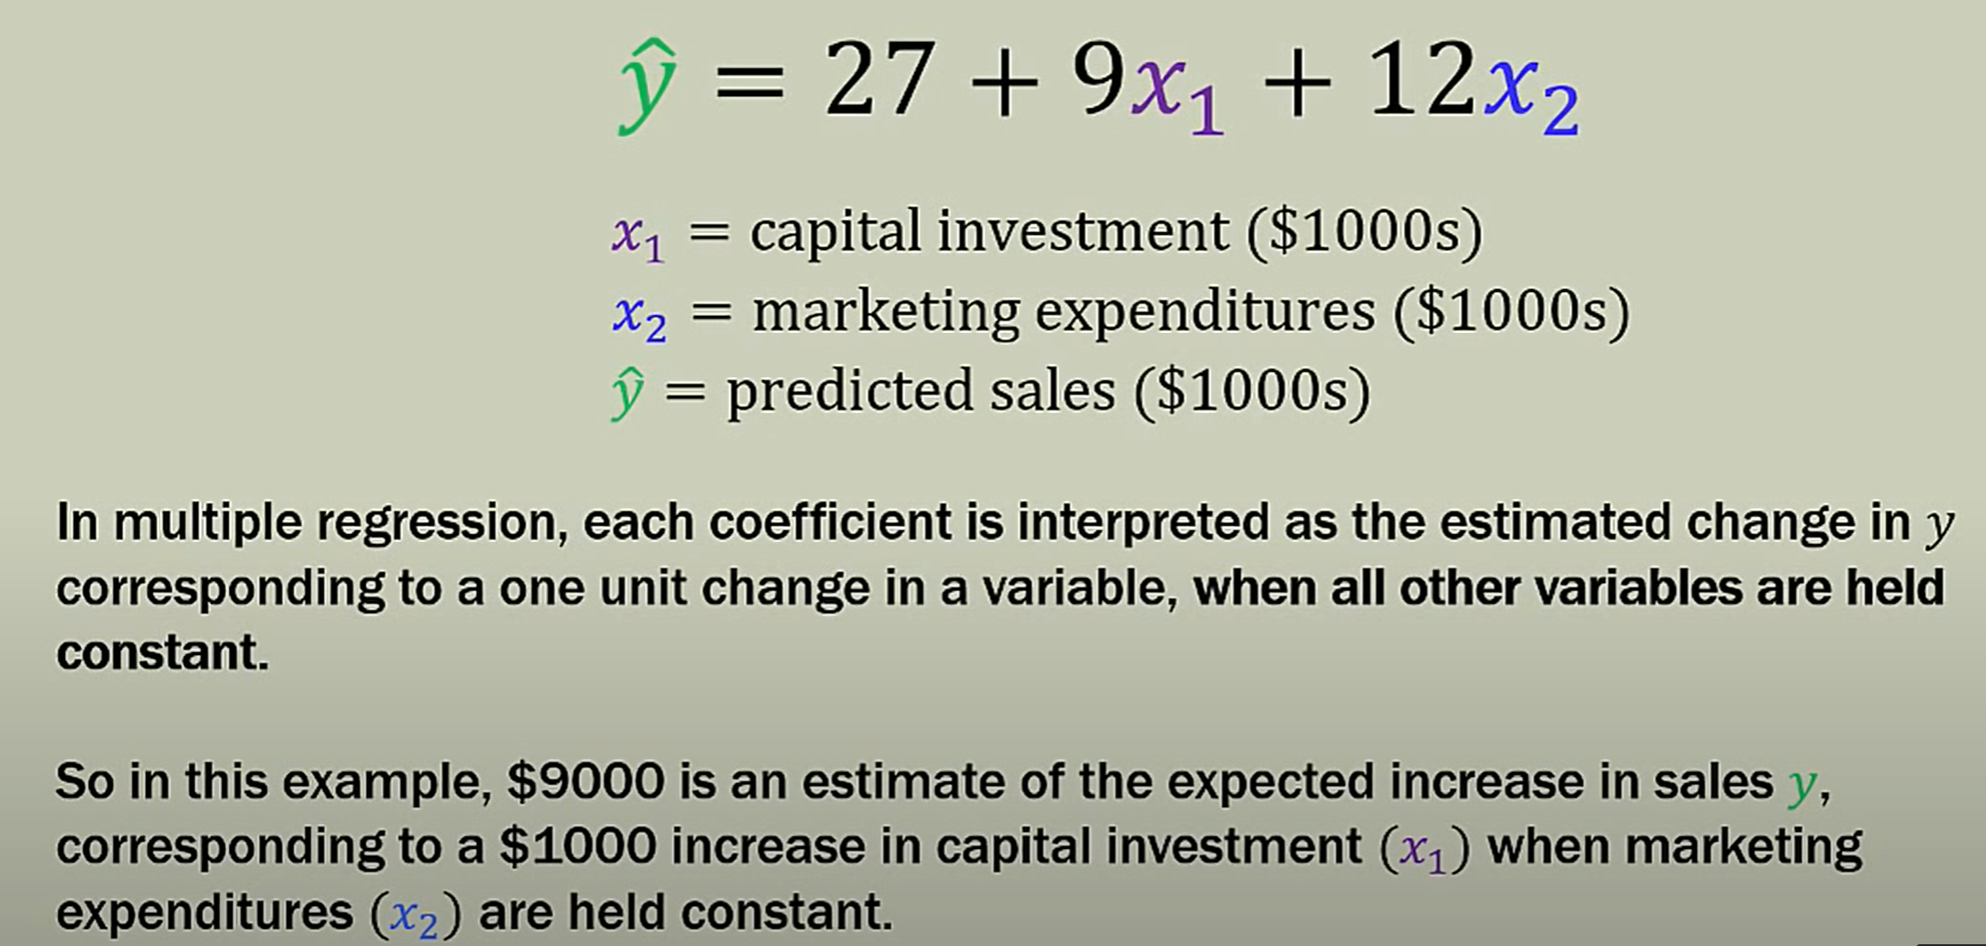
Interpreting Coefficients

Slide 22
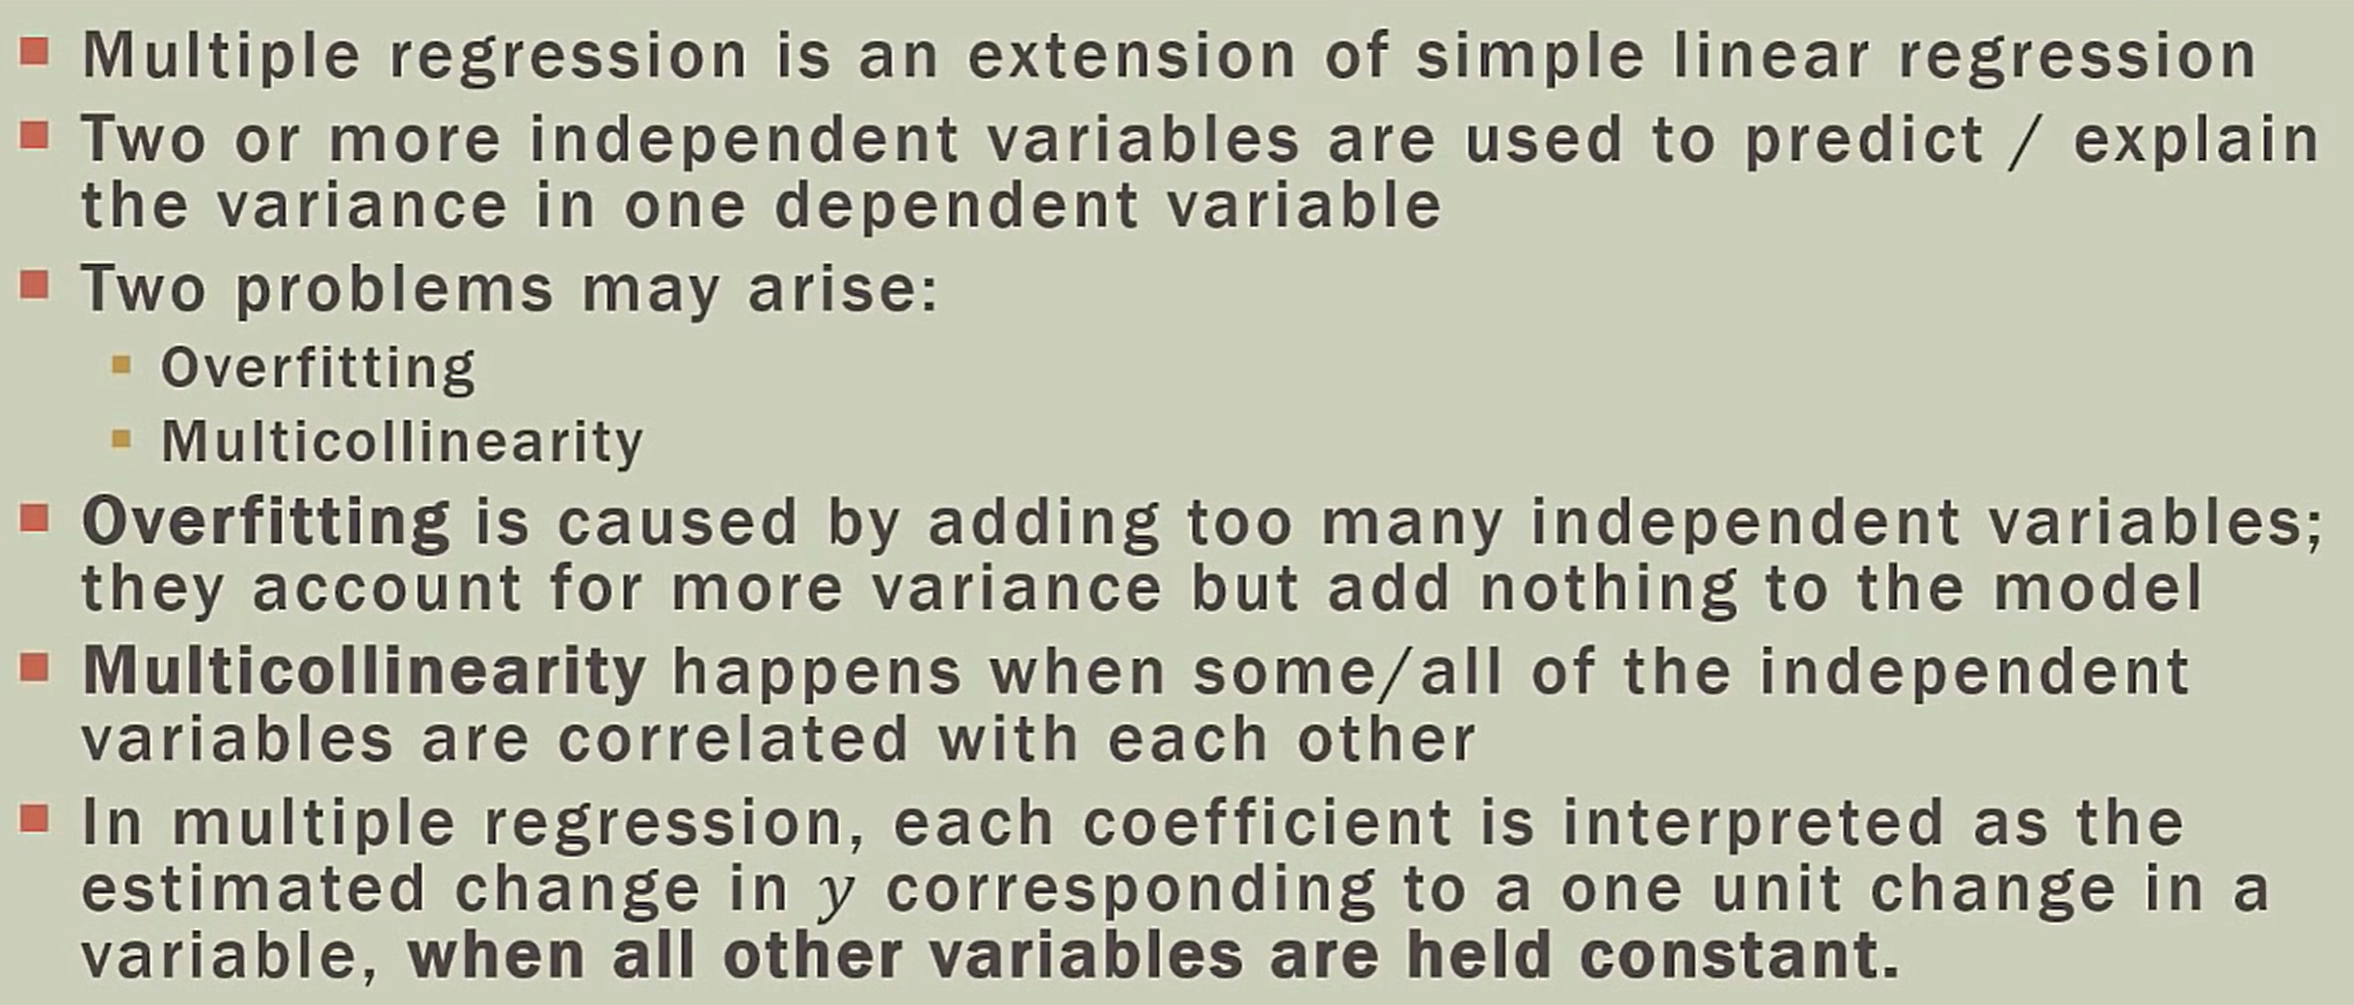
Multiple Regression: Key Points

Slide 23
Datasets
Note that for model development we over-sample favorable respondents to help us develop a robust understanding of what drives response, whereas the holdout data typically has a proportion of favorable respondents that approximates the response rate in the entire target population.
Entire target population of the pilot study is N = 20,000.
Training dataset: Size: 1600 and 400 responded (over-sampled)
Testing (hold-out) dataset: Size: 2300 and 204 responded; base response rate = 204/2300 = 8.87% ➔ Apply the model to score subjects for better response rate (hit rate).
N=20000 > 1600 + 2300
The company has a database of 50,000 readers in the Midwest. It plans to target a subset of them for a similar mail campaign using the predictive model.➔ The response rate should be better than 8.87%
Notes:
The Right Way to Oversample in Predictive Modeling
6 minute read
Imbalanced datasets spring up everywhere. Amazon wants to classify fake reviews, banks want to predict fraudulent credit card charges, and, as of this November, Facebook researchers are probably wondering if they can predict which news articles are fake.
In each of these cases, only a small fraction of observations are actually positives. I’d guess that only 1 in 10,000 credit card charges are fraudulent, at most. Recently, oversampling the minority class observations has become a common approach to improve the quality of predictive modeling. By oversampling, models are sometimes better able to learn patterns that differentiate classes.
However, this post isn’t about how this can improve modeling. Instead, it’s about how the timing of oversampling can affect the generalization ability of a model. Since one of the primary goals of model validation is to estimate how it will perform on unseen data, oversampling correctly is critical.

Slide 24
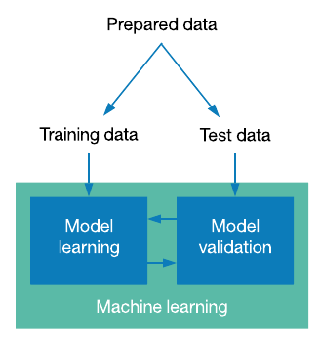
Model Training, Validation, and Deployment
Statistical Learning/Machine Learning/Deep Learning
N=20,000 > 3,900
New
Data
50,000
Testing
Data
2300(204)
Acquire Data
Model & estimated
model parameters,
estimated model hit rates
Infer Model
Parameters➔ Coefficients
3900
Clean/Prepare Data
Deploy Validated
Model
Validate
Model
Split
Data
Train
Model
Train
Model
Deploy
Model
Training
Data
Recommendation
Decision
Prediction
1600(400)
Adjust Models
精準營銷
over-sampling of positive cases
because of imbalance data

Slide 25
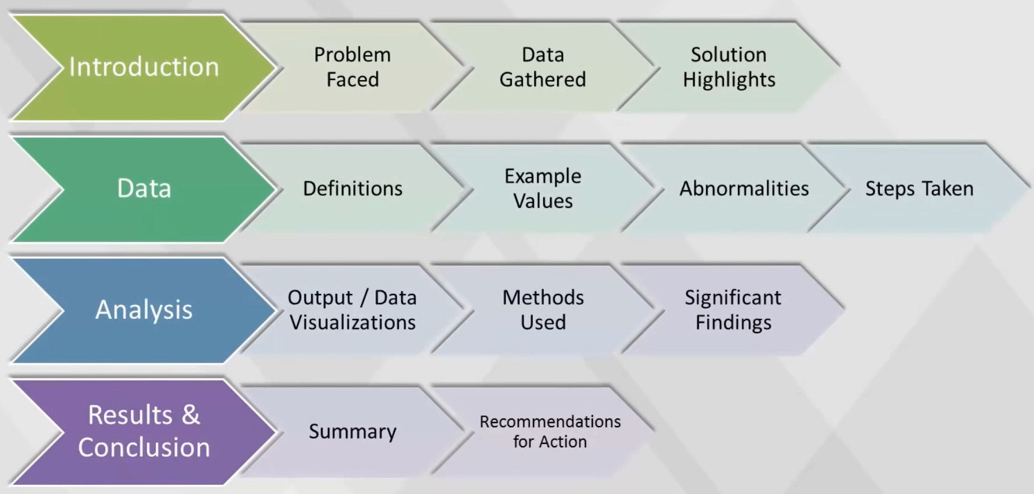
Analytical Report Template
Video at 1:14:55 Analytical report

Slide 26
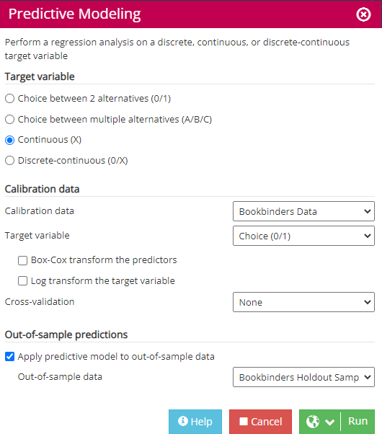
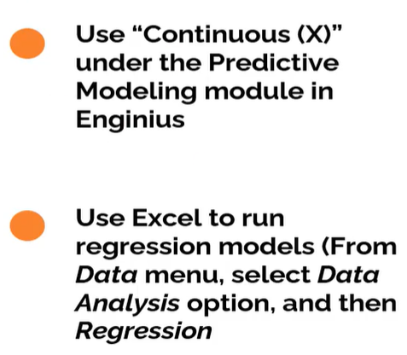
Linear Regression in Enginius or Excel

Slide 27

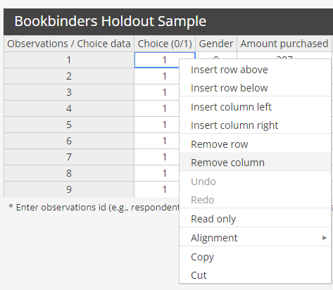
How to handle the Error message for Out-Of-Sample
We still need the target variable (Choice) for model validation. ➔
Compare the predictive model's score of each observation with the actual choice.

Slide 28
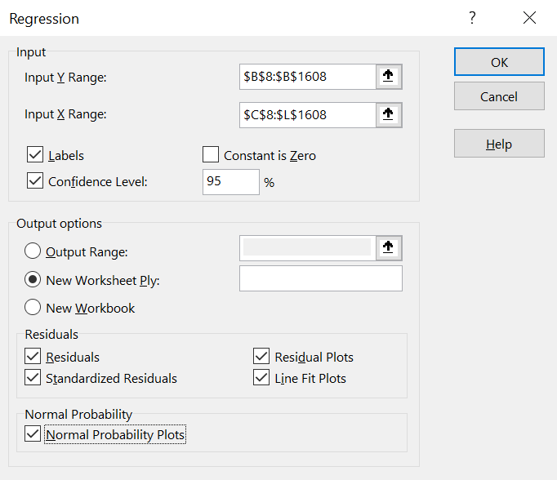
Excel Analysis Pack Regression Model
Using Training Data Set The first 1600 observations
We can use Excel Analysis Pack to Solve the Linear Regression Problem. ➔ Infer coefficients(推斷係數)
Use Enginius to infer coefficients for both Linear and Logistic Regression

Slide 29
Coefficients and P-Value
 | Coefficients | Standard Error | t Stat | P-value | Lower 95% | Upper 95% | Lower 95.0% | Upper 95.0%
Intercept | 0.363775141 | 0.030715567 | 11.84335 | 4.53E-31 | 0.303527846 | 0.42402244 | 0.30352785 | 0.42402244
Gender | -0.131015366 | 0.020017289 | -6.54511 | 8E-11 | -0.170278437 | -0.0917523 | -0.1702784 | -0.0917523
Amount purchased | 0.000277372 | 0.000110973 | 2.49945 | 0.012539 | 5.97027E-05 | 0.00049504 | 5.9703E-05 | 0.00049504
Frequency | -0.009091958 | 0.002177586 | -4.17525 | 3.14E-05 | -0.013363201 | -0.0048207 | -0.0133632 | -0.0048207
Last purchase | 0.098444731 | 0.01354546 | 7.267729 | 5.71E-13 | 0.071875879 | 0.12501358 | 0.07187588 | 0.12501358
First purchase | -0.001993394 | 0.00181476 | -1.09843 | 0.272181 | -0.005552969 | 0.00156618 | -0.005553 | 0.00156618
P_Child | -0.128095601 | 0.016412581 | -7.80472 | 1.07E-14 | -0.160288191 | -0.095903 | -0.1602882 | -0.095903
P_Youth | -0.101173332 | 0.020214915 | -5.00489 | 6.21E-07 | -0.14082404 | -0.0615226 | -0.140824 | -0.0615226
P_Cook | -0.142684831 | 0.016559075 | -8.61672 | 1.63E-17 | -0.175164762 | -0.1102049 | -0.1751648 | -0.1102049
P_DIY | -0.136165796 | 0.019741327 | -6.8975 | 7.61E-12 | -0.174887579 | -0.097444 | -0.1748876 | -0.097444
P_Art | 0.115869454 | 0.019455996 | 5.955463 | 3.19E-09 | 0.077707334 | 0.15403157 | 0.07770733 | 0.15403157
the overall F-test can find that the coefficients are significant jointly
while the t-tests can fail to find significance individually.
https://statisticsbyjim.com/regression/interpret-coefficients-p-values-regression/ with a video

Slide 30
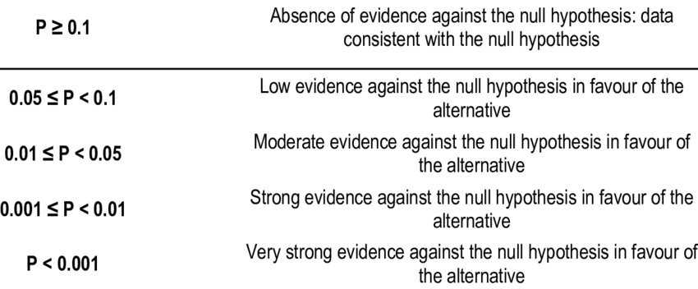
P-Value Range
(IV does do not help in prediction of DV)
(significant level)
(significant level)
When a coefficient of an independent variable's P<0.05 (5%) means that changes of this independent variable contributes to the changes in the dependent variable.
https://statisticsbyjim.com/regression/interpret-coefficients-p-values-regression/

Slide 31
Interpretating coefficients
Based on the significant coefficients, for both the logit or regression models, we see that:
Men are less likely to buy.
The greater the amount previously purchased, the greater the likelihood of responding to the current mailing (although the coefficient for Amount Purchased is shown as 0.00027, it is actually positive and significant). ➔ unit of measure
The more frequently the individual buys, the lower the likelihood the customer would respond to the current mailing, i.e., the Art History of Florence has the potential to increase loyalty by attracting customers who typically have fewer interactions with the company.
The longer the time since last purchase (Recency), the greater the likelihood the customer would respond to the current mailing. Similar to the result we saw with frequency, this product seems to appeal to those who are less loyal customers of BBBC. Thus, it can enhance retention of those customers. Typically, the Recency variable has a negative coefficient in most direct marketing programs.
The greater the number of art books bought, the greater the likelihood of responding to the current mailing.
The greater the number of any of the other book types, the lower the likelihood of responding to the current mailing.
 | Coefficients
Intercept | 0.363775141
Gender | -0.131015366
Amount purchased | 0.000277372
Frequency | -0.009091958
Last purchase | 0.098444731
First purchase | -0.001993394
P_Child | -0.128095601
P_Youth | -0.101173332
P_Cook | -0.142684831
P_DIY | -0.136165796
P_Art | 0.115869454

Slide 32
P-Value in Regression
in a regression model the P-Value for each independent variable tests the Null Hypothesis that there is “No Correlation” between the independent and the dependent variable, this also helps to determine the relationship observed in the sample also exists in the larger data.
So if the P-Value is less than the significance level (usually 0.05) then your model fits the data well. A significance level of 0.05 indicates a 5% risk of concluding that a difference exists between the variables when there is no actual difference.
It is standard practice to use the p-values of an independent variable to decide whether to include the variable in the final model. Keeping variables that are not statistically significant can reduce the model’s precision.
https://statisticsbyjim.com/regression/interpret-coefficients-p-values-regression/

Slide 33
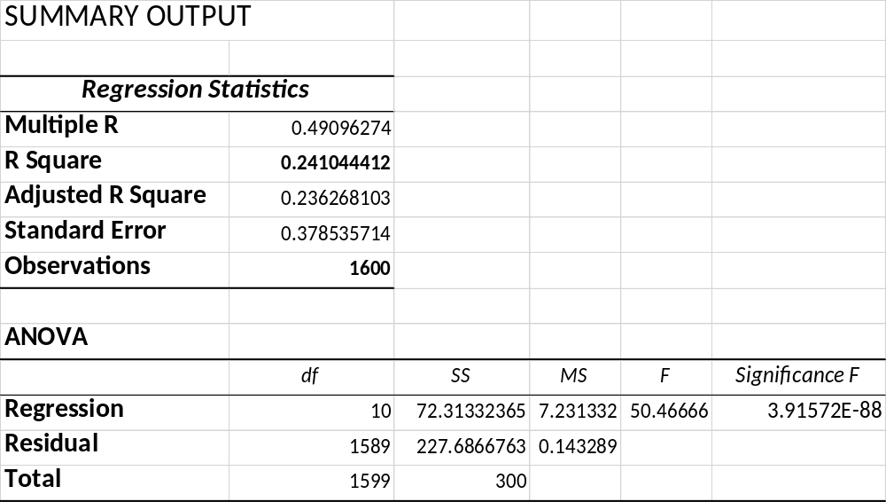
R Square and Significant F
The F-test for overall significance has the following two hypotheses:
The null hypothesis states that the model with no independent variables fits the data as well as your model.
The alternative hypothesis says that your model fits the data better than the intercept-only model.
Significance F
F is the probability that our regression model is wrong and needs to be discarded! We want the significance F or the probability of being wrong to be as small as possible.
Commonly used significance levels are 1%, 5%, or 10%.
https://statisticsbyjim.com/regression/interpret-r-squared-regression/ with a video
https://www.graduatetutor.com/statistics-tutor/interpreting-regression-output/

Slide 34
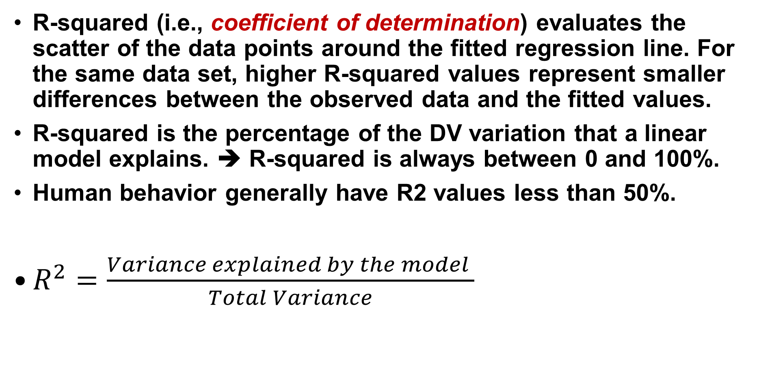
R-Squared and the Goodness-of-Fit
R-squared (i.e., coefficient of determination) evaluates the scatter of the data points around the fitted regression line. For the same data set, higher R-squared values represent smaller differences between the observed data and the fitted values.
R-squared is the percentage of the DV variation that a linear model explains. ➔ R-squared is always between 0 and 100%.
Human behavior generally have R2 values less than 50%.
$R^{2}=\frac{Variance explained by the model }{Total Variance}$
** https://statisticsbyjim.com/regression/interpret-r-squared-regression/ with a video
https://www.graduatetutor.com/statistics-tutor/interpreting-regression-output/

Slide 35
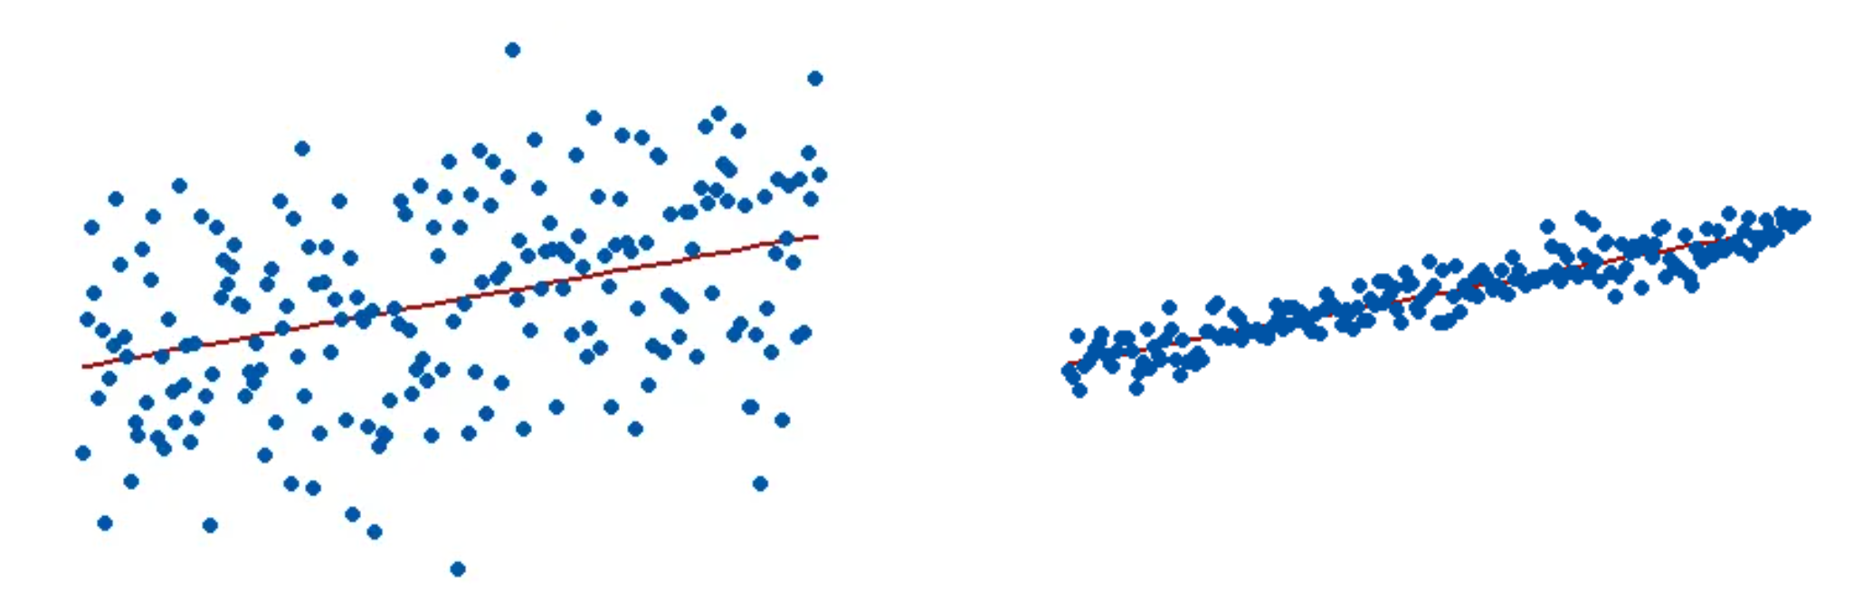


Visual Representation of R-squared
A good model can have a low R² value. On the other hand, a biased model can have a high R² value!
$$R^{2}=15\%$$
$$R^{2}=85\%$$

Slide 36
Validate Models: Analytics/Predictions with the Models
Use test mailing data to build model(s) to predict customers' likely responses to a mailing of a promotional brochure for the book, Art History of Florence.
  RFM Model (Use "Nested lf" or vlookup() functions in Excel)
  Ordinary Least Squares (OLS) Regression Model (Use Excel or Enginius)
  Logit/Choice Model (Use Enginius)
Compute the predicted response score from each model for each customer in a hold-out sample. Sort holdout sample according to these scores (use one model to score at a time).
Estimate predicted purchases of the book from the sorted hold-out sample for any targeting plan (the sorted list will be different for each model).
Compute expected profit and gain charts for a mailing to the selected group of customers based on their sorted predicted response score. (Profit = [Expected Revenue] – [Total Mailing Costs]
= Estimated purchase qty * Profit Margin - Total Mailing Costs mailing
Notes:
Multinomial logistic regression is used to predict categorical placement in or the probability of category membership on a dependent variable based on multiple independent variables. The independent variables can be either dichotomous (i.e., binary) or continuous (i.e., interval or ratio in scale). Multinomial logistic regression is a simple extension of binary logistic regression that allows for more than two categories of the dependent or outcome variable. Like binary logistic regression, multinomial logistic regression uses maximum likelihood estimation to evaluate the probability of categorical membership.

Slide 37
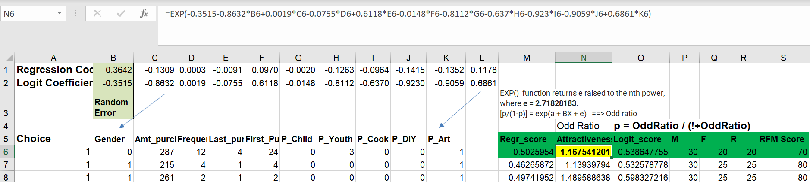
How to Calculate Prediction Scores
Regression Score: Formula for M6 ➔ =0.364228-0.13092048*B6+0.0002736*C6-0.0090876*D6+0.0970286*E6-0.002*F6-0.1262584*G6-0.096356*H6-0.1414907*I6-0.135231*J6+0.117849*K6
Attractiveness: Formula for N6 ➔ =EXP(-0.3515-0.8632*B6+0.0019*C6-0.0755*D6+0.6118*E6-0.0148*F6-0.8112*G6-0.637*H6-0.923*I6-0.9059*J6+0.6861*K6)
** Logit Score: Formula for O6 = =(N6)/(1+N6) ⬅ More advanced
RFM Score = R+F+M

Slide 38
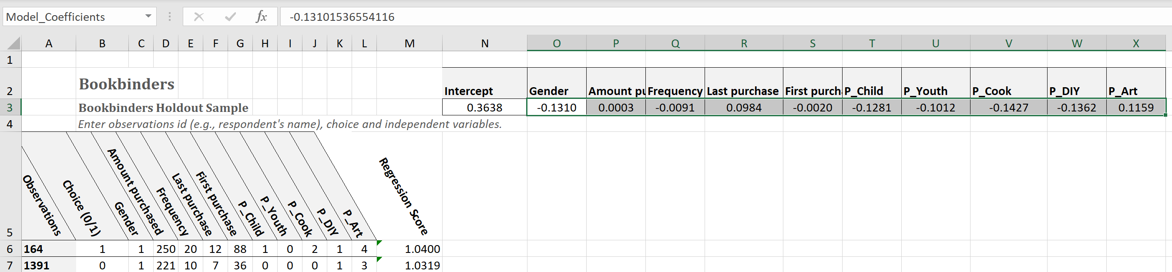
Calculating LR Model Predicted Score using Testing Dataset
M6 Regression Score: =+$N$3+SUMPRODUCT((C6:L6), Model_Coefficients)
Learn the use of SUMPRODUCT()
$\hat{y}=Intercept+ b_{1}∗Gender$ ${+ b}_{2}∗AmountPurchased$ + … ${+ b}_{10}∗P_Art$

Slide 39
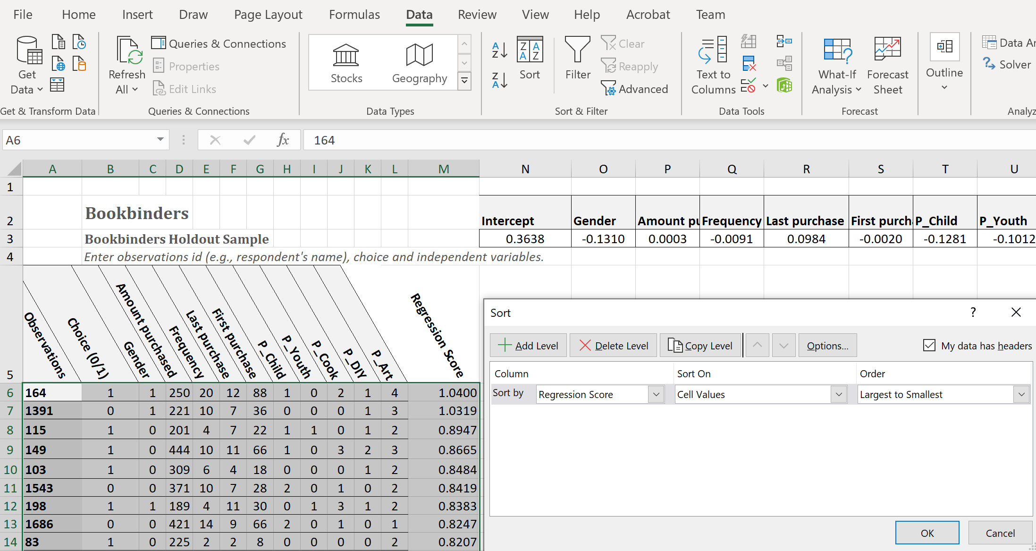
Sort the Testing Data by Regression Score
Data > Sort ➔ Sort by Regression Score in descending order
Sort the dataset by Regression Score in descending order

Slide 40
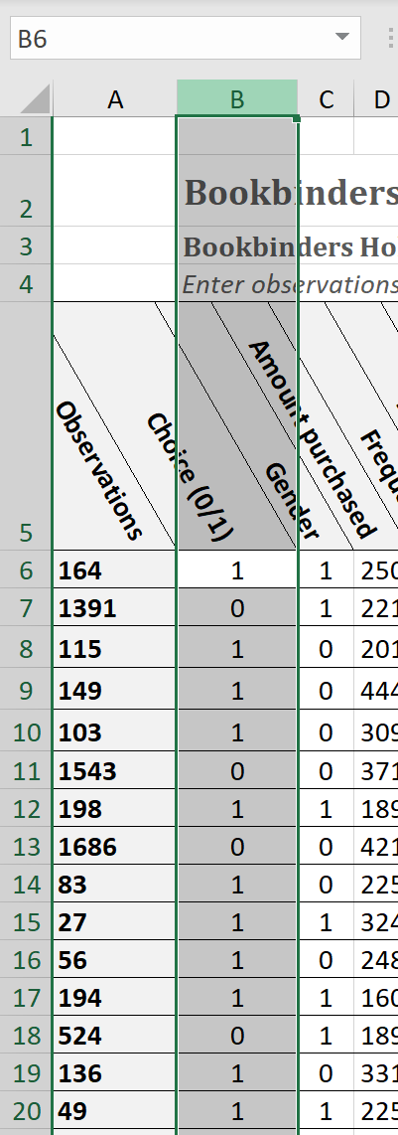
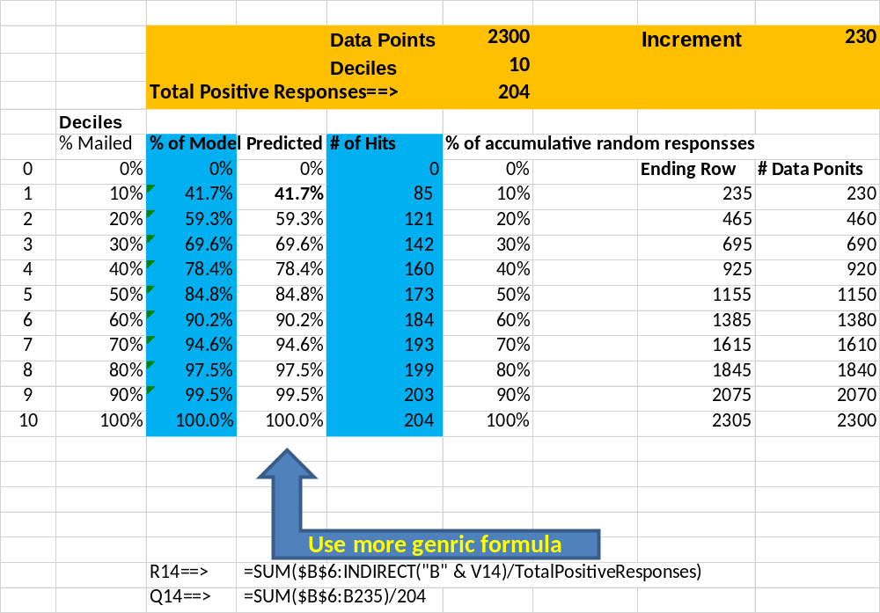
Calculate Hit Rates by Deciles Based on the Model Prediction over Testing Data
EstimatedModelHitRate for Top N Dociles Targeted using Model Prediction ➔ Calculated with Testing Data
Sorted by Regression Score in descending order

Slide 41
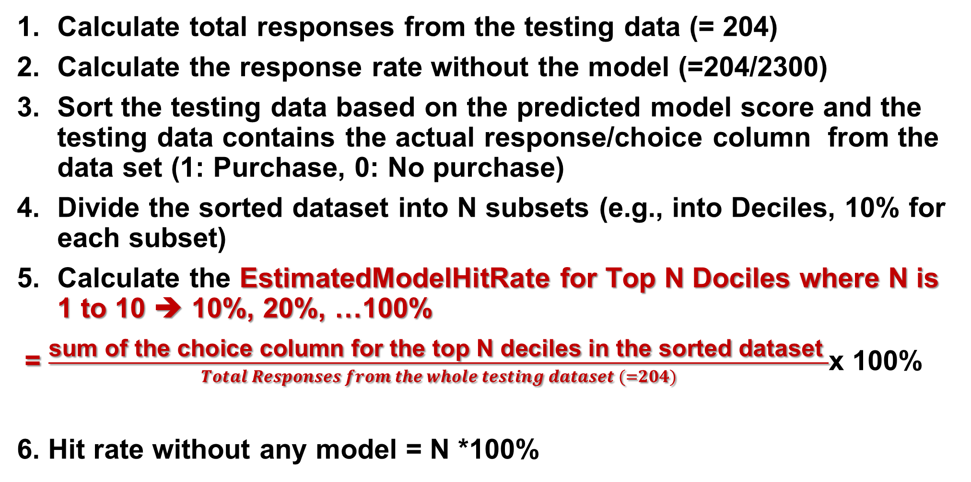
EstimatedModelHitRate for Top N Dociles
Calculate total responses from the testing data (= 204)
Calculate the response rate without the model (=204/2300)
Sort the testing data based on the predicted model score and the testing data contains the actual response/choice column from the data set (1: Purchase, 0: No purchase)
Divide the sorted dataset into N subsets (e.g., into Deciles, 10% for each subset)
Calculate the EstimatedModelHitRate for Top N Dociles where N is 1 to 10 ➔ 10%, 20%, …100%
= $\frac{\text{sum} \text{of} \text{the} \text{choice} \text{column} \text{for} \text{the} \text{top} \text{N} \text{deciles} \text{in} \text{the} \text{sorted} \text{dataset} }{Total Responses from the whole testing dataset (=204)}$x 100%
6. Hit rate without any model = N *100%

Slide 42
Deploy the model to Calculating the Profit of a Targeted Campaign
Bookbinders is considering a similar mail campaign in the Midwest for up to 50,000 customers.
The allocated cost of mailing is $0.65/addressee (including postage) for the art book, and if ordered the book costs Bookbinders $15 to purchase and mail plus an additional overhead for each book at 45 percent of cost of the book
The selling price of the book is $31.95.
Profit Margin per book = $31.9 - $15 - $15*45% = $10.20
Which customers (% of top ranked customer sorted by predictive regression model score) should Bookbinders target?
How much more profit would you expect the company to generate using the model as compared to sending the mail offer to the same % of customers from the entire list randomly?

Slide 43
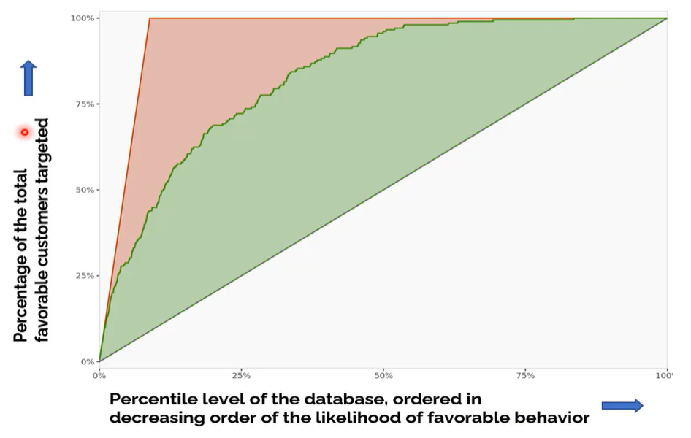
Gain Charts for Assessing the Potential "Lifts" from Deploying a Model
神槍手百發百中
Naïve or Random Model
亂槍打鳥

Slide 44
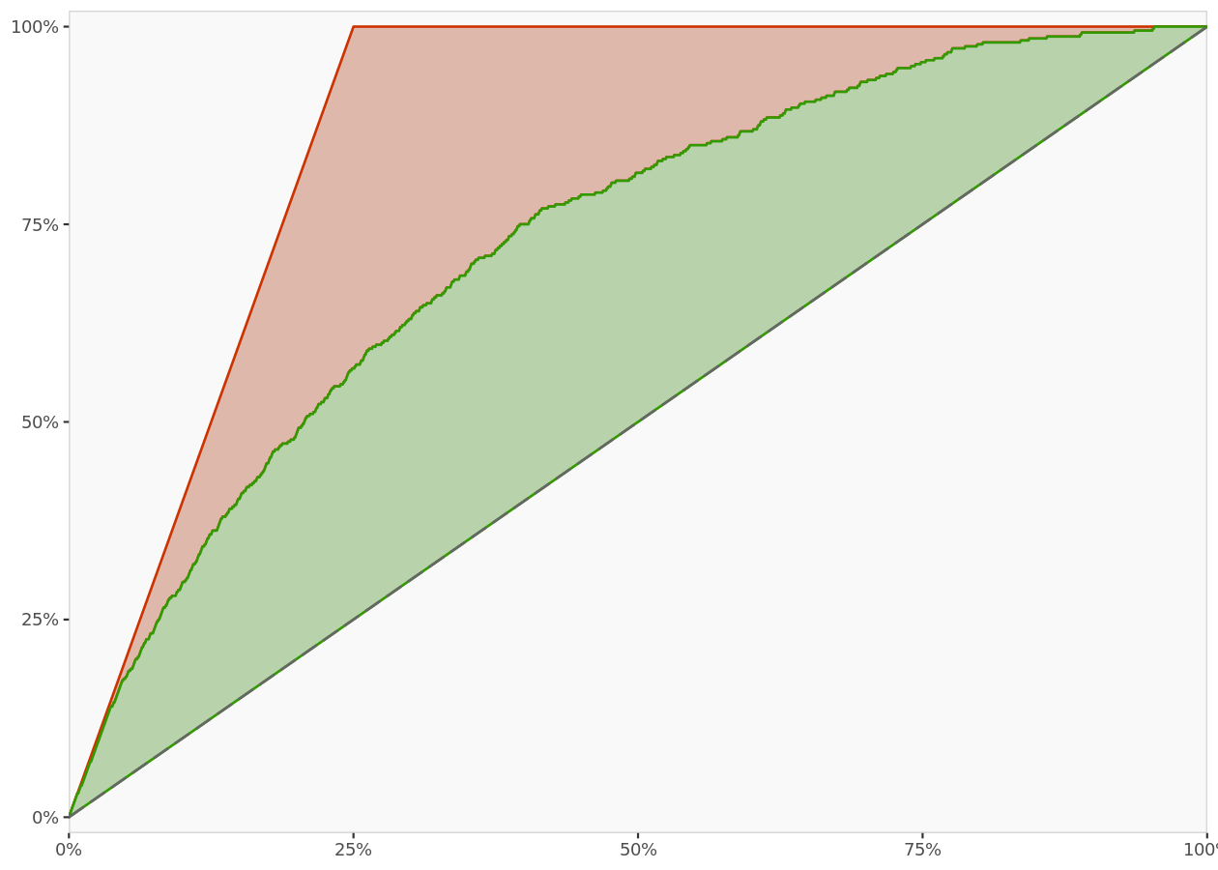
Gain chart and lift
A gain chart is a representation of how good a predictive model is at identifying the most favorable responses.
The X-axis represents the percentile level of the population ordered in decreasing order of choice likelihood, and the Y-axis represents the percentage of the actual favorable choices recovered by the model.
The diagonal line represents performance of a model that randomly assigns the choice an individual makes from the set of choice alternatives. The red line represents a true model that predicts the choices perfectly. The green line represents the performance of the focal model.
神槍手百發百中
亂槍打鳥
Notes:
https://www.listendata.com/2014/08/excel-template-gain-and-lift-charts.html

Slide 45
Model Deployment➔Calculate Profit for a Targeted Mailing Promotion of 50000
Profit for mailing out a selected % of customers based on their regression model predicted score (sorted in descending order) [by deciles].
Total = Total Numbers of Customers from the pool (50000)
ResponseRate = 204/2300 (based on the test dataset) = 8.87% (basic response rate)
EstimatedResponsesTotal is target all in the pool = 50000 * ResponseRate = 4435
TotalCustomerTargeted = Total * Top N Dociles Targeted = Total * N * 10%
Profit with model = EstimatedResponsesTotal * EstimatedModelHitRate * ProfitMargin – TotalCustomerTargeted * $0.65
Profit without the model= EstimatedResponsesTotal * (N * 10%) * ProfitMargin – TotalCustomerTargeted * 0.65
mailing cost per addressee = $0.65
N ∈ [0, 1, 2, ….10]
Profit Margin = $10.20 per book sold excluding the mass mailing costs
EstimatedModelHitRate for Top N Dociles Targeted based on Model scores

Slide 46
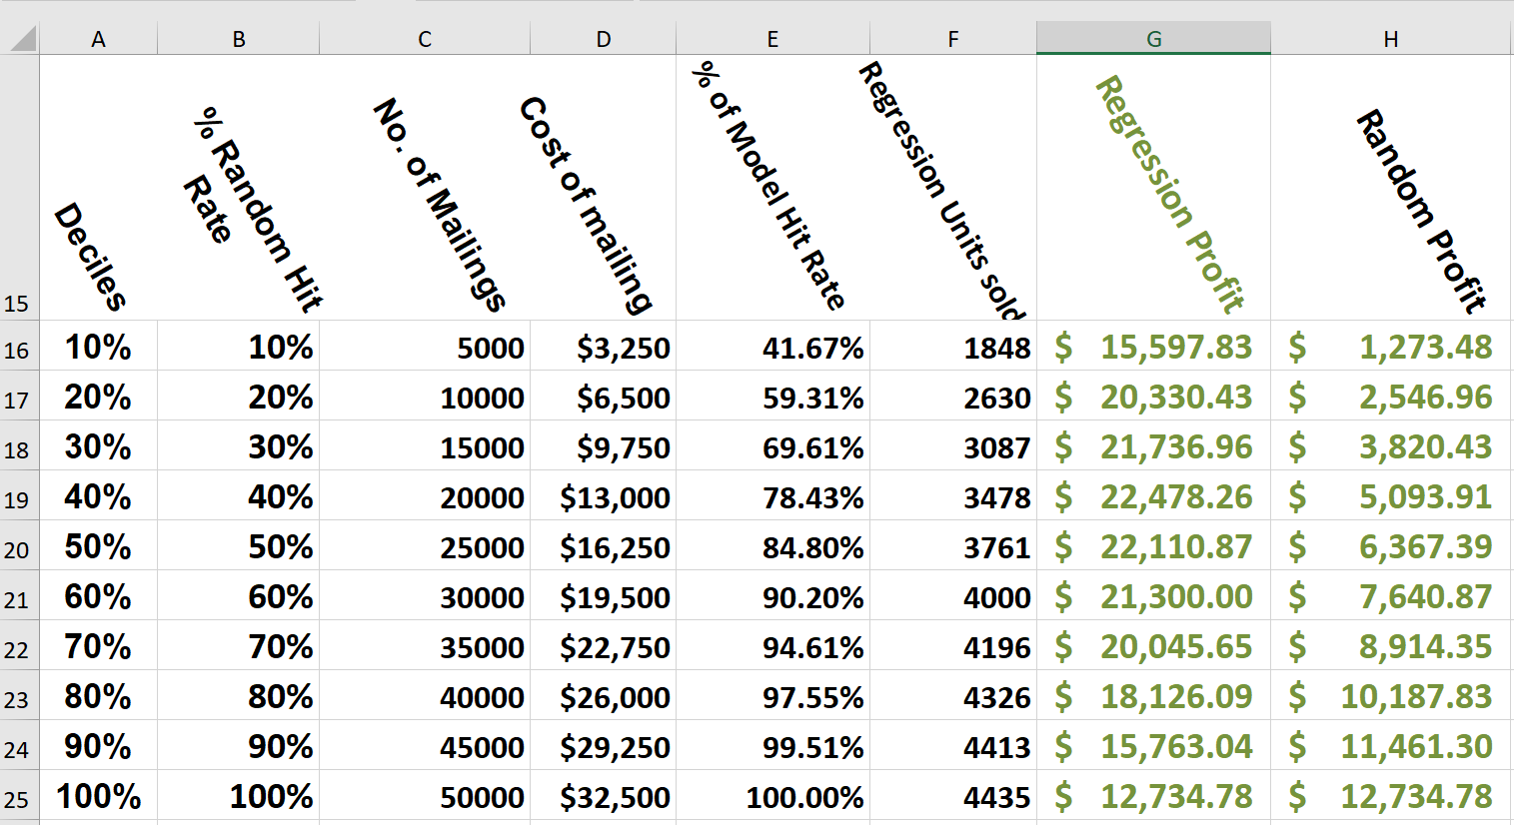
Linear Regression Model's Profit Calculation over New Dataset
D16 =+UnitCostOfMailing*C16
Size of new dataset for
model deployment
= 50000
F16=+E16*TotalResponse
G16=F16*ProfitMargin-D16
H16
=C16*RandomResponseRate*ProfitMargin-D16
Profit=Total No. of Responses * ResponesRate*ProfitMargin - Mailing Cost
ResponseRate = Random Hit Rate vs. Model Hit Rate
This come from previous analysis using testing data

Slide 47
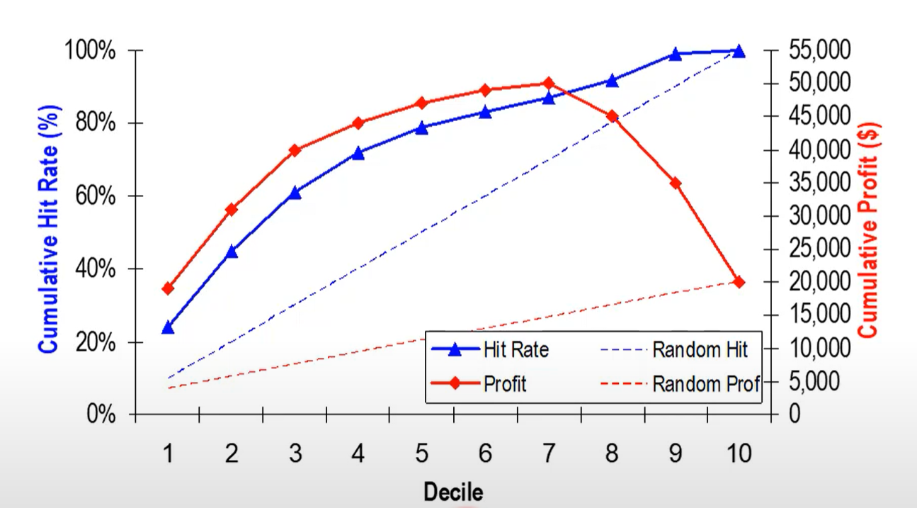
Develop "Lift/Gain Charts" and Choose a Model for Implementation
Maximizing the profit?
Max of
the profit
% of Customers responded in favor

Slide 48
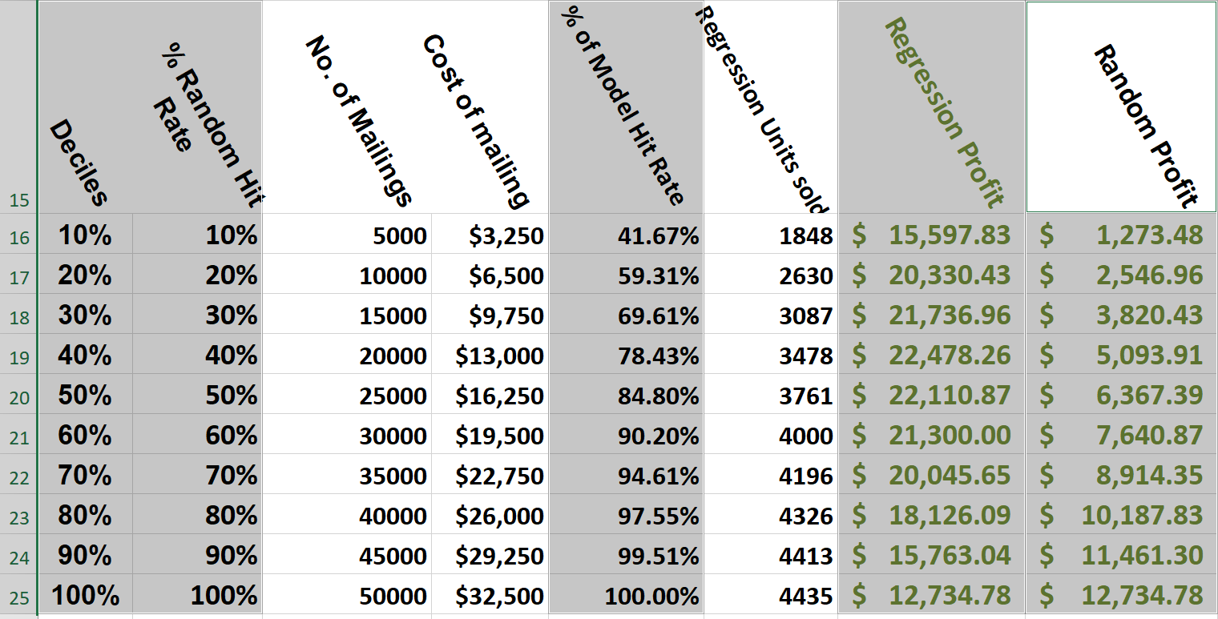
Charting Regression Model's Profit over New Dataset of 50000 Customers
Highlight the following 5 columns (press CTRL key)
The 1st columns is for X-Axis; the last two columns are for Secondary Y Axis because it has a different scale ($) instead of the % for the primary Y Axis.
Max

Slide 49
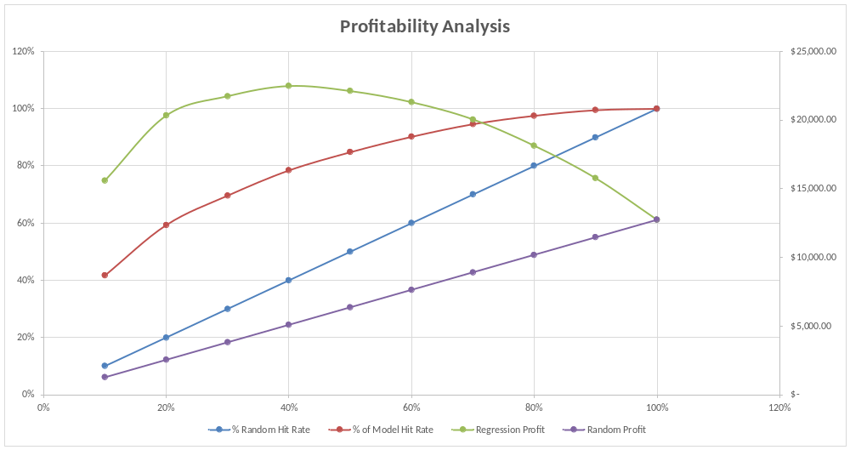
Paste as an Excel Object➔ You can and may need to adjust chart format in PowerPoint

Slide 50
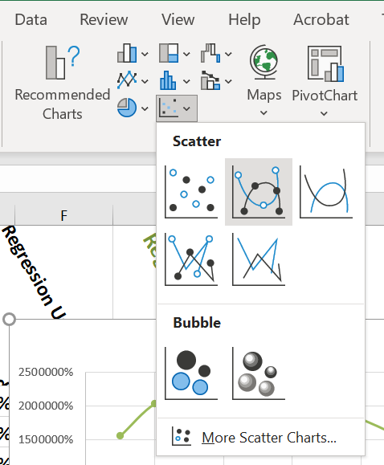
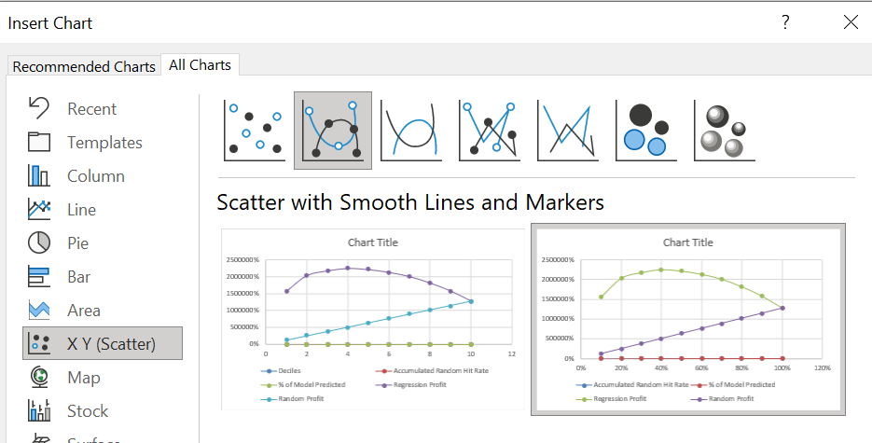




Insert Chart after Charting Data Set Das Been Selected

Slide 51
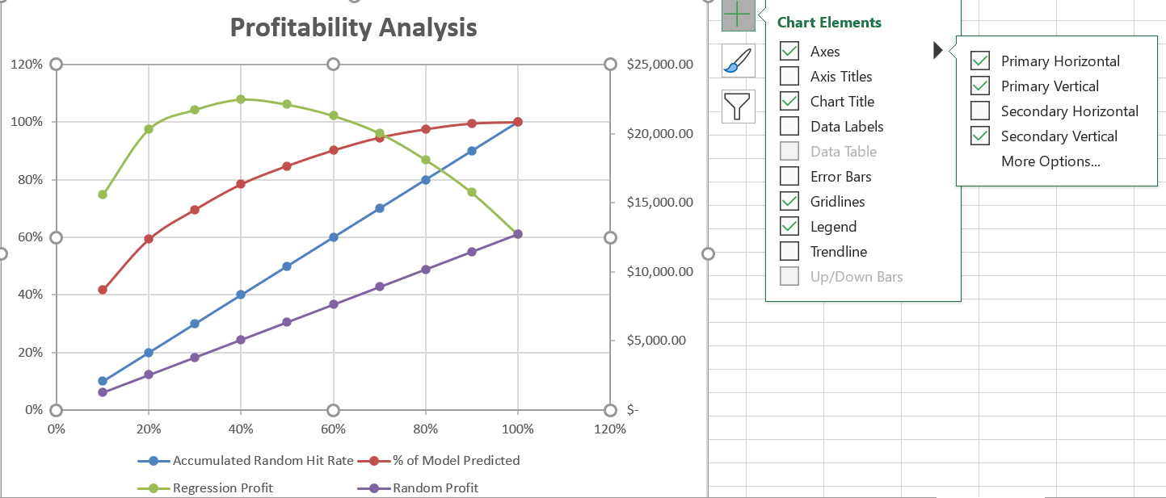









Select Secondary Vertical (Y-Axis)
Click this!!

Slide 52
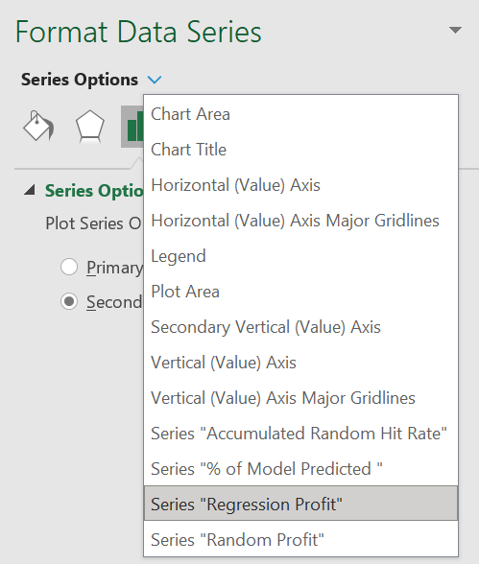



Set up Secondary Y-Axis for the Two Profit Data Series
Select the Regression Profit and Random Profit data series and set its Series Option
Plot series on to
Secondary Axis
You need to do it one data series at a time.

Slide 53
Model Training, Validation, and Deployment
Statistical Learning/Machine Learning/Deep Learning
New
Data
50,000
N=20,000
Testing
Data
2300(204)
Acquire Data
Model & estimated
model parameters,
estimated model hit rates
Infer Model Parameters
3900
Clean/Prepare Data
Deploy Validated
Model
Validate
Model
Split
Data
Train
Model
Train
Model
Deploy
Model
1600(400)
over-sampling➔
Recommendation
Decision
Prediction
Training
Data
Adjust Model Parameters

Slide 54
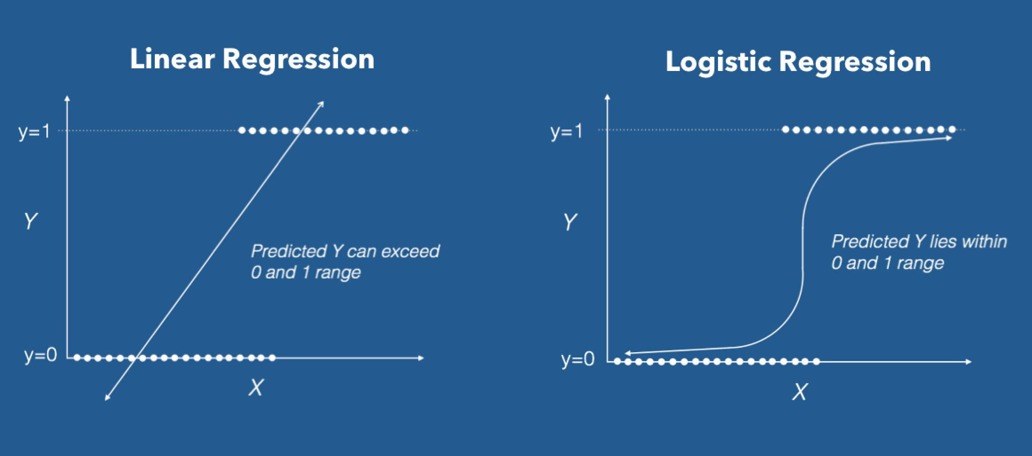
From Linear Regression to Logistic Regression
Logistic regression is a statistical model that in its basic form uses a logistic function to model a binary dependent variable
https://en.wikipedia.org/wiki/Logistic_regression

Slide 55
Logistic Regression
Logistic regression is a predictive modelling algorithm that is used when the Y variable is binary categorical.
Y can take only two values like 1 or 0.
The goal is to determine a mathematical equation that can be used to predict the probability of event when Y is 1.
Once the equation is established, it can be used to predict the Y when the Xs are known.
Examples
Spam Detection : Predicting if an email is Spam or not
Credit Card Fraud : Predicting if a given credit card transaction is fraud or not
Health : Predicting if a given mass of tissue is benign or malignant
Marketing : Predicting if a given user will buy an insurance product or not
Banking : Predicting if a customer will default on a loan.
Logistic Regression - A Complete Tutorial with Examples in R (machinelearningplus.com)

Slide 56
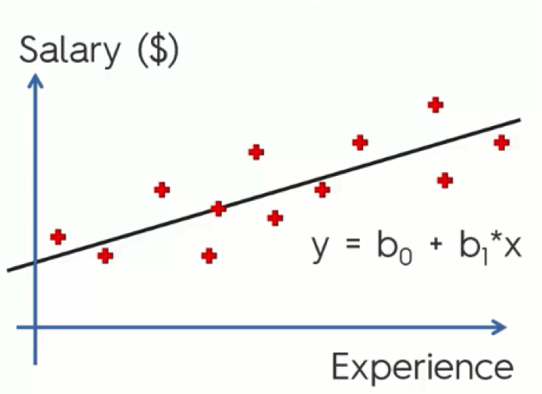
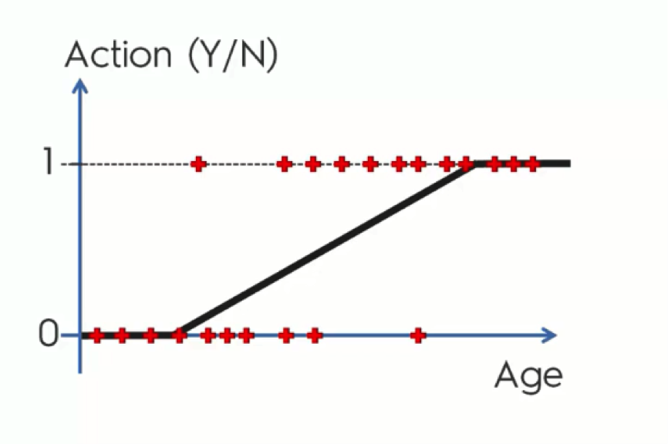
Linear Regression vs. Logit Regression
Logistic regression is a tool for making inferences and predictions in situations where the dependent variable is binary, i.e., an indicator for an event that either happens or doesn't.
Rad this ➔ https://regressit.com/logistic.html
Notes:
For those who aren't already familiar with it, logistic regression is a tool for making inferences and predictions in situations where the dependent variable is binary, i.e., an indicator for an event that either happens or doesn't. For quantitative analysis, the outcomes to be predicted are coded as 0’s and 1’s, while the predictor variables may have arbitrary values. An ordinary linear regression model is inappropriate in this situation. You can try it, but the results are often illogical or inapplicable. The errors of a linear regression model fitted to binary data cannot be normally distributed nor identically distributed for all values of the predictions, the predictions and confidence limits can stray outside the unit interval, and such a model is incapable of finely discriminating among probabilities that are close to 0 or 1, which can be important in situations where there are small but non-zero chances of events with large consequences.
A logistic regression model approaches the problem by working in units of log odds rather than probabilities. Let p denote a value for the predicted probability of an event's occurrence. The corresponding log odds value is LogOdds = LN(p/(1-p)), where LN is the natural log function. The inverse relationship is p = EXP(LogOdds)/(1+EXP(LogOdds)) where EXP is the exponential function. As the value of p goes from 0 to 1, the corresponding value of log odds goes symmetrically from minus infinity to plus infinity, and vice versa. A probability of 1/2 corresponds to a log odds value of 0, and in general the log odds value for probability p is minus the log odds value for probability 1-p.

Slide 57
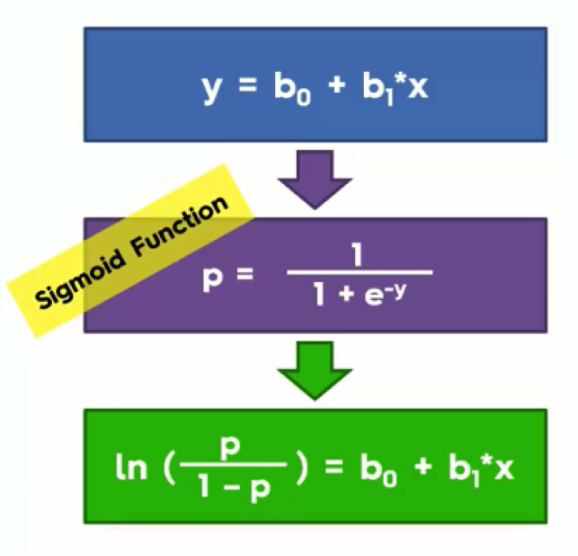
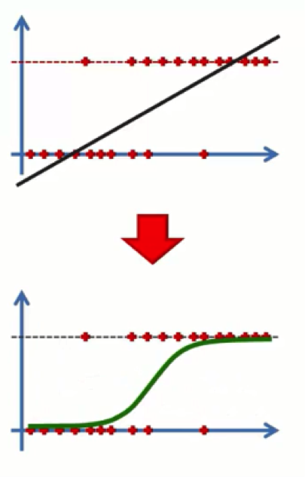
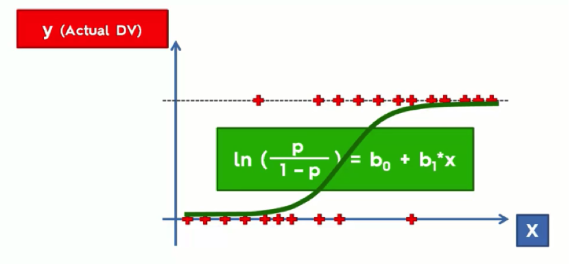
Logit Regression
The inverse relationship is p = EXP(LogOdds)/(1+EXP(LogOdds)) where EXP is the exponential function.
p = probability that y is 1; 1-p = probability that y is 0
p/(1-p) Odd that y is 1
ln(p/(1-p)) = ln(odd) = logit or LogOdds
Regression & Classification - Logistic Regression
Notes:
The natural logarithm of a number is its logarithm to the base of the mathematical constant e, which is an irrational and transcendental number approximately equal to 2.718281828459. The natural logarithm of x is generally written as ln x, log_{e} x, or sometimes, if the base e is implicit, simply log x.

Slide 58
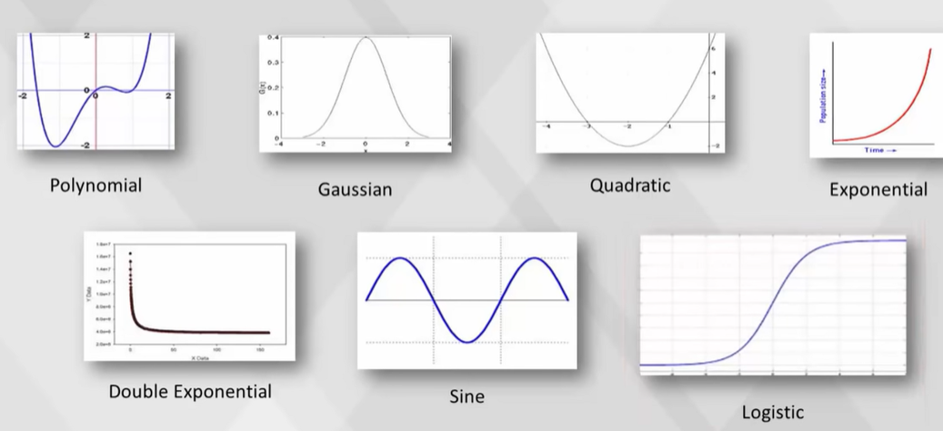
The Need for Logistic Regression
** Logistic regression (Video )

Slide 59

Odd Ratio and Prediction
** Logistic regression (Video )

Slide 60
The Logistic Regression Model
Binary logistic regression is a type of regression analysis where the dependent variable is a dummy variable (coded as 0 or 1).
The "logit" model solves these problems:
ln[p/(1-p)] = a + BX + e ➔ Logit or
[p/(1-p)] = exp(a + BX + e) = Odd (A: Attractiveness)
p/(1-p) = A ➔ p = A –Ap➔p+Ap = A ➔ p(1+A)=A ➔ p = A/(1+A)
where:
ln is the natural logarithm, log_{exp}, where exp=2.71828 (Euler's number e, 自然常数、自然底数)
p is the probability that the event Y occurs, p(Y=1)
p/(1-p) is the "odds ratio" ➔ "Attractiveness"
ln[p/(1-p)] is the log odds ratio, or "logit"
All other components of the model are the same.
www.appstate.edu/~whiteheadjc/service/logit/intro.htm

Slide 61


Using Enginius to Run Logit Regression

Slide 62
Using Enginius to Run Logit Regression
Model parameters
Model parameters reported here have been estimated on the entire calibration data.
Model statistics
For identification purposes, parameters for the alternative 0 have been fixed to 0. These are not reported here. P-value = probability that parameter estimate is different from zero only by chance.
 | Parameter | Standard deviation | P-value
Intercept | -0.3569 | 0.2146 | 0.0962
Gender | -0.8643 | 0.1376 | 0.0000
`Amount purchased` | 0.0019 | 0.0008 | 0.0161
Frequency | -0.0756 | 0.0166 | 0.0000
`Last purchase` | 0.6211 | 0.0941 | 0.0000
`First purchase` | -0.0148 | 0.0128 | 0.2486
P_Child | -0.8251 | 0.1173 | 0.0000
P_Youth | -0.6732 | 0.1457 | 0.0000
P_Cook | -0.9295 | 0.1193 | 0.0000
P_DIY | -0.9104 | 0.1435 | 0.0000
P_Art | 0.6736 | 0.1273 | 0.0000
Confusion matrix (%)
The global hit rate of the model is 80%. The diagonal elements represent alternative-specific hit rates.
 | Predicted 0 | Predicted 1
Actual 0 | 93% | 7%
Actual 1 | 60% | 40%
Global Hit Rate =
(Actual 0 and predicted as 0 + Actual 1 and predicted as 1) /
Total Count

Slide 63


Prediction Using Logistic Regression
M8 =EXP($B$2+SUMPRODUCT($C$2:$L$2, C8:L8))
N8 = =M8/(1+M8)
Predicted (O8) =IF(N8>=0.5, 1, 0)

Slide 64

Confusion Matrix
R6 =COUNTIF($O$8:$O$2307, 0)
R S
Frequency table for predicted choices
 | Alternative 0 | Alternative 1
Count | 2092 | 207
Frequency | 91.00% | 9.00%
6
7
R7 = R6/($R$6+$S$6)

Slide 65
Logistic Regression - Interpretation of Coefficients and Forecasting
Video 8: Logistic Regression - Interpretation of Coefficients and Forecasting – YouTube Video
Interpret Logistic Regression Coefficients [For Beginners] – Quantifying Health
How are Logistic Regression & Ordinary Least Squares Regression (Linear Regression) Related? Why the “Regression” in Logistic? | by Rakshith Vasudev | Towards Data Science

Slide 66
Extra Reference: RFM Analysis
Marketing Analytics: Data-Driven Techniques with Microsoft Excel (2014)
  https://apprize.best/microsoft/excel_4/
** Chapter 30: RFM Analysis and Optimizing Direct Mail Campaigns
  https://apprize.best/microsoft/excel_4/31.html
Excel Files for Marketing Analytics | Download
Exercise Solution Files for Marketing Analytics | Download

Slide 67
The End

Slide 68
RegressIt: Free Excel Add In
RegressIt is a powerful Excel add-in which performs multivariate descriptive data analysis and regression analysis with high-quality table and chart output in native Excelformat. The linear regression version of the program runs on both Macs and PC's, and there is also a separate logistic regression version for PC only supporting both Linear Regression and Logitsic Regression.
RegressIt slide show
https://regressit.com/free-download.html
  RegressItPC download page (PC only)
  RegressItMac download page (Mac users)
  RegressItLogistic download page (PC only for both Linear & Logistic Regression)
*https://regressit.com/logistic.html (read it for general knowledge of Logistic Regession)
** https://regressit.com/RegressItLogisticNotes.pdf
https://regressit.com/regressitlogistic.html
https://regressit.com/titanic-example.html Titanic Logistic Regression Example

Slide 69
Trade-Off
Privacy vs Relevance in microtargeting marketing

Slide 70

Customer Needs and Customer Value Measurement

Slide 71

Steps in Analytical Modeling for Behavior-Based Micro-Targeting

Slide 72

Computing Profitability of Each Customer – Sorted List
Example

Slide 73

RFM Model Scoring Rule Table Example

Slide 74

Evaluating Classifiers: Gains and Lift Charts
http://www2.cs.uregina.ca/~dbd/cs831/notes/lift_chart/lift_chart.html
https://www.youtube.com/watch?v=1dYOcDaDJLY
% of positive responses
Notes:
See another video at https://www.youtube.com/watch?v=IwCUZQllVVI Base
Watch this first https://www.youtube.com/watch?v=2f-J5yWQpAQ working with a binary classification problem. Evaluating the 'positive' group of predictions. Define: precision, recall (sensitivity), and specificity.

Slide 75

Gain charts, for fun and profit
https://cooldata.wordpress.com/2011/05/26/lift-charts-for-fun-and-profit/

Slide 76

Lift Chart

Slide 77


Slide 78

Sigmoid Function
y=1/(1+e^(-x))
The sigmoid is a function that only occupies the range from 0 to 1 and it asymptotes (漸近線
) both values. This makes it very handy for binary classification with 0 and 1 as potential output values. When a linear regression model gives you a continuous output like -2.5, -5, or 10, the sigmoid function will turn it into a value between 0 and 1.
Denote x as z➔
https://programmathically.com/the-sigmoid-function-and-binary-logistic-regression/

Slide 79

Prediction of Y using
Instead of a probability, we want an actual prediction. Unlike the probability, the prediction will be valued at either 0 or 1. Like the probability, however, it is not based on any actual observations.
We have the dependent variable(DV) on the Y-axis. This is the (yes/no) variable.
Probability "p-hat."
Project any point that is below the 50% line downward to 0, while anything above it would be projected upward to 1.
Regression & Classification - Logistic Regression

Slide 80







Slide 81



z =
y is probability p that y is true (1) in the formula above.
ln(p/(1-p) = z can be predicted using coefficients of the linear regression.
p | Odd Ratios= p / (1-p)
0 | 0
0.1 | 0.111
0.2 | 0.250
0.3 | 0.429
0.4 | 0.667
0.5 | 1.000
0.6 | 1.500
0.7 | 2.333
0.8 | 4.000 | =0.8/0.2
0.9 | 9.000
0.999 | 999.000

Slide 82
Logistic Regression Coefficients Interpretation
In logistic regression the y variable is categorical (and usually binary), but use of the logit function allows the y variable to be treated as continuous.
Because of the logit function, logistic regression coefficients represent the log odds that an observation is in the target class (“1”, "respond") given the values of its X variables.
“For every one-unit increase in [X variable], the odds that the observation is in (y class) are [coefficient] times as large as the odds that the observation is not in (y class) when all other variables are held constant.”
https://towardsdatascience.com/interpreting-coefficients-in-linear-and-logistic-regression-6ddf1295f6f1
Read also ‘Logit’ of Logistic Regression; Understanding the Fundamentals | by Saptashwa Bhattacharyya | Towards Data Science

Slide 83
Dummy Variable
In statistics and econometrics, particularly in regression analysis, a dummy variable^{[a]} is one that takes only the value 0 or 1 to indicate the absence or presence of some categorical effect that may be expected to shift the outcome.
They can be thought of as numeric stand-ins for qualitative facts in a regression model, sorting data into mutually exclusive categories (such as smoker and non-smoker).
https://en.wikipedia.org/wiki/Dummy_variable_(statistics)

Slide 84

Logistic Regression - Interpretation of Coefficients and Forecasting
Video 8: Logistic Regression - Interpretation of Coefficients and Forecasting
** Watch this: https://www.youtube.com/watch?v=eX2sY2La4Ew
You may want to start from here ** Video 7: Logistic Regression – Introduction https://www.youtube.com/watch?v=gNhogKJ_q7U&t=13s

Slide 85
Using a Logistic Regression Model to Make Prediction
A logistic regression model makes predictions on a log odds scale [ ln(p/(1-p) where 0<= p <= 1] you can covert the log odds scale to the probability p.
Suppose you wanted to get a predicted probability p for breast feeding for a 20 year old mom. Knowing that intercept is -3.654 & coefficient is 0.157 The log odds would be:
-3.654+20*0.157 = -0.514 ⬅ log odds (calculated via a linear regression)
You need to convert from log odds to odds. Most other statistical software will use a natural logarithm (base e) rather than a base 10 logarithm. To move back from the log odds scale to the odds scale you need an antilog, which for the natural logarithm, is an exponential function.
exp(-0.514) = 0.598
Now you need to convert from odds to probability.
0.598 / (1+0.598) = 0.374
See also www.appstate.edu/~whiteheadjc/service/logit/intro.htm
⬅➔ p/1-p = A (odd, attractiveness)
⬅➔ p = A/(1+A)

Slide 86

Extra

Slide 87


Slide 88

Logistic Regression Details Pt 2: Maximum Likelihood
https://www.youtube.com/watch?v=BfKanl1aSG0
Also refer to https://www.real-statistics.com/logistic-regression/basic-concepts-logistic-regression/

Slide 89

标称型数据 Nominal Data
Nominal VS Ordinal Data: Definition, Examples and Difference (intellspot.com)

Slide 90

Use Confusion Matrix for Model Evaluation

Slide 91

Nominal VS Ordinal Data: Definition, Examples and Difference (intellspot.com)

Slide 92
Nominal Scales And Measurement.
A lot of market segmentation examples are a basis for creating nominal scales and measurement.
51 Market Segment Examples To Define Your Target Groups (intellspot.com)

Slide 93

序数数据
(等级数据)
)
Nominal VS Ordinal Data: Definition, Examples and Difference (intellspot.com)

Slide 94
Multinomial Logit (MNL) Model
The MNL model offers a way to operationalize the theory of rational choice within a probabilistic framework. The objective of the MNL model in Marketing is to predict the probabilities that a customer would choose each of several alternatives which are available on a particular purchase/choice occasion.
A multinomial logistic regression (or multinomial regression for short) is used when the outcome variable being predicted is nominal and has more than two categories that do not have a given rank or order. This model can be used with any number of independent variables that are categorical or continuous.
https://en.wikipedia.org/wiki/Multinomial_logistic_regression
TN03 - Choice Modeling

Slide 95

exploratory analysis groups similar variables into dimensions.
Predict
purchase
decision
market
segmentation
Perceptual Mapping
(used for Positioning)
Correlation analysis focuses on the strength/the degree of a relationship between two variables.while regression analysis emphasis on the prediction while
Predict how the relationship between two variables (e.g., between advertising and sales)
**Marketing Analysis Methods and Techniques: Key Tools (intellspot.com)

Slide 96

Statistics 101: Logistic Regression, Logit and Regression Equation - YouTube
Notes:
Just to add how logit inverse can be derived. It is the swapping of graph between x and y. You have to isolate the x(p in this case) and express x in terms of y. So, if logit is y and y = ln(p/1-p), e^y = p/1-p e^y-e^y(p) = p re arranging the terms, it comes out p = e^y/1+e^y, So, now your p (or x) has taken the role of y, and y has taken the role of x and you can swap variables y = e^x/1+e^x

Slide 97


Slide 98

** Statistics 101: Logistic Regression, Logit and Regression Equation - YouTube

Slide 99


Slide 100

Estimated Regression Equation

Slide 101
Correlation Matrix and Multicollinearity in Regression
One key assumption of multiple linear regression is that no independent variable in the model is highly correlated with another variable in the model.
Collinearity refers to a condition whereby we have a pair of heavily correlated "independent" variables to each other in data.
Multicollinearity may make it difficult for us to distinguish between independent variables’ isolated effects on a dependent variable.
Correlation Matrix and use Excel to create Correlation Matrix.
One simple method among others is:
Removing variables. A straightforward method of correcting multicollinearity is removing one or more variables showing a high correlation.
Statistical significance claims that an outcome resulting from testing or experimentation is unlikely to occur randomly.
Notes:
How to Detect and Correct Multicollinearity in Regression Models
March 1, 2021
The interpretability of machine learning models helps us understand the predictions made by a model. Interpretable models are desirable. The interpretability of a regression model may be affected, when determining individual feature effects in a model become unreliable. A reason for this is multicollinearity. In this article we will explore multicollinearity; we will also learn a method to detect and fix it.
Table of contents
Multicollinearity and variables
The problem
Causes
Test to check for multicollinearity
Addressing multicollinearity
Prerequisites
In order to follow it article along, a basic understanding of not only machine learning but also regression models is needed. Here’s a helpful article on supervised learning algorithms.
Multicollinearity and variables
A dependent variable is a variable that holds the occurrence being studied. It is one that varies as a result of the independent variable. An independent variable is one that is controlled to test the dependent variable.
We will show the relationship between the two types of variables using the equation:
y=f(x)y=f(x)
Where xx is the independent variable and yy is the dependent variable. In the context of machine learning, a dependent variable is the target variable. It is the value that should be predicted. An independent variable is a predictor. It is used to predict a dependent variable.
Collinearity refers to a condition whereby we have a pair of heavily correlated features to each other in data. For a variable to be considered an independent variable, it has to be distinct from other variables.
It has to be independent of other variables. This means that we should not have the ability to derive this variable’s values by using other independent variables. Consider another equation of a dependent variable concerning independent variables below.
y=c+m1x1+m2x2+m3x3+…+mnxny=c+m1x1+m2x2+m3x3+…+mnxn
Say x1x1 represents total exam marks. x2x2 represents exam one. x3x3 is exam two. To get the value of x1x1, we can add x2x2 and x3x3.
This shows that x1x1 is not independent. The implication is that there is strong multicollinearity between x1x1, x2x2 and x3x3. We can say multicollinearity is present in a regression model when two or more independent variables show a high correlation.
The problem
It affects the interpretability of a regression model since it compromises the statistical significance of independent variables. Statistical significance claims that an outcome resulting from testing or experimentation is unlikely to occur randomly.
Instead, an occurrence can be attributed to a specific cause. Statistical significance reflects the confidence level of an outcome. Multicollinearity may make it difficult for us to distinguish between independent variables’ isolated effects on a dependent variable.
We should note that multicollinearity may not have a significant impact on the accuracy of the model. It has a greater impact on the reliability when finding the effects of individual features of the model.
Causes
There are many reasons why multicollinearity may occur.
It may occur as a result of:
The inclusion of identical variables. For example, one may have identical variables in a dataset, such as mass in kilograms and mass in pounds.
Creation of new variables that are dependent on others. When we create variables that depend on other variables, we introduce redundant information to the model. As such, we may inadvertently encourage the occurrence of multicollinearity.
Inadequate data. In some cases, when the data is inadequate, we may experience multicollinearity. This is due to the small sample size, which might, in turn, experience great variance.
Variance Inflation Factor
To learn the severity of multicollinearity, there are a few tests that may be carried out. We will focus on the use of the variance inflation factor (VIF).
The variance inflation factor represents the quotient of model variance with many terms against model variance with a single term. It is the score of an independent variable representing the degree to which other independent variables explain the variable.
In simpler terms, it is a measure of the levels of multicollinearity in a group of regression variables. The variance inflation factor not only pinpoints correlation between independent variables but the strength of the correlation. As such, it works out the magnitude of the correlation between independent variables.
VIF has a range that signifies various levels of multicollinearity. A VIF value of 1 is non-collinear. We consider it to be negligible.
VIF values ranging between 1 and 5 are moderate. They represent a medium level of collinearity. Values of more than 5 are highly collinear. We consider these to be extreme.
It is advisable to keep the levels of multicollinearity moderate. The VIF scores for the independent variables should be lower than 5. However, it is worth noting that this figure may vary depending on publication or use case. Some use a value of 10 to denote extreme multicollinearity.
Let’s look at VIF mathematically.
Say we want to compute the VIF for the jthjth predictor.
The VIF can be calculated using the formula:
VIFi=11–R2iVIFi=11–Ri2
Where R2iRi2 is the coefficient obtained by regressing the ithith independent variable on the remaining predictors. As shown below, we can also compute the tolerance and use it to detect multicollinearity.
VIFi=11–R2i=1ToleranceVIFi=11–Ri2=1Tolerance
The tolerance is the reciprocal of VIF.
If R2iRi2 is 0, the VIF is equal to 1. As a result, we cannot predict the variance of the remaining predictors. The ithith predictor is not correlated to the others.
This is why, as we mentioned previously, when VIF is 1, collinearity is negligible. Multicollinearity is absent from the regression model. For a better understanding of VIF, you may check out an example here.
As much as high VIFs are a cause of concern, there exist situations where they can be ignored.
In such cases multicollinearity will not manifest. These include:
High VIFs in control variables. When high VIFs are present in control variables but not in variables in consideration, they can be ignored. This would mean that the variables we are interested in are neither collinear to the control variables nor each other. As such, there is no impact on the coefficients of regression (R2i)(Ri2).
Involvement of powers and products of other variables. We may have high VIFs resulting from the involvement of multiplications or products or other variables. Consider a regression model with yy and y2y2 as independent variables. In this case, the resulting multicollinearity is not harmful.
Dummy variable representing more than two categories. A dummy variable is used to represent a specific attribute with two or more clear categories. It takes the value of 0 or 1 to show the absence or presence of a given property. If a dummy variable represents more than two categories with a high VIF score, multicollinearity might not exist. If there is a fragment of cases in a given category, the variables will always give high VIF values. This is regardless of whether there is a correlation between categorical variables and other variables.
Addressing multicollinearity
If we conclude that multicollinearity poses a problem for our regression model, we can attempt a handful of basic fixes.
Removing variables. A straightforward method of correcting multicollinearity is removing one or more variables showing a high correlation. This assists in reducing the multicollinearity linking correlated features. It is advisable to get rid of variables iteratively. We would begin with a variable with the highest VIF score since other variables are likely to capture its trend. As a result of removing this variable, other variables’ VIF values are likely to reduce.
More data. Statistically, a regression model with more data is likely to suffer less variance due to a larger sample size. This will reduce the impact of multicollinearity.
Using techniques such as partial least squares regression (PLS) and principal component analysis (PCA). A takeaway from this paper on partial least squares regression for multicollinearity is that PLS can lessen variables to a smaller grouping with no correlation between them. PLS, like PCA, is a dimensionality reduction technique. PCA reduces the dimension of data through the decomposition of data into independent factors. Therefore, new variables with no correlation between them are created. This article explains how PCA handles multicollinearity.
Centering the variables. Centering is defined as subtracting a constant from the value of every variable. It redefines the zero point for a given predictor to become the value we subtracted. Here’s how we can center the variables. We can first calculate the mean of every single independent variable. The next step would replace each variable value with the difference between the values and the mean. The result of this is that the interpretation of the regression coefficients remains unchanged while reducing the impact of multicollinearity by making the correlation between variables much more manageable. This post contains an example of how centered variables lead to reduced multicollinearity.
Wrapping up
Multicollinearity can be described as a data disturbance in a regression model. It threatens to undermine the output of a model. However, it can be detected and addressed. We have explored its causes, the problem it poses, how to detect and address it.
Until next time, good luck!
References and further reading
Multicollinearity — How does it create a problem?
Multicollinearity – How to fix it?
Multicollinearity in Regression Analysis: Problems, Detection, and Solutions
What is Multicollinearity? Here’s Everything You Need to Know
Multicollinearity in Data Science
“Multicollinearity” a Problem or an Opportunity?
A Note on Partial Least Squares Regression for Multicollinearity (A Comparative Study)
Principal Component Analysis to Address Multicollinearity
How to remove Multicollinearity in dataset using PCA?
What Can I Do About Multicollinearity? Solutions for Multicollinearity in Multiple Regression

Slide 102
Using R for the Case
RPubs - DA 6813: Case Study 2 - Bookbinders Book Club in R Studio

Slide 103
Customer Retention: Another Case in R
Data ➔ https://cran.r-project.org/web/packages/SMCRM/index.html
  https://cran.r-project.org/web/packages/SMCRM/SMCRM.pdf
  Excel data?? ➔ https://media.wiley.com/product_ancillary/02/11199932/DOWNLOAD/Chapter%203%20-%20Customer%20Acquisition%20Data.xls
R code ➔ https://rpubs.com/alexisleo/da6813-casestudy-customerretention
Additional reference: How To Win The Retention Game: A Case Study With Lingopie
Data Sets for Kumar and Petersen (2012). Statistical Methods in Customer Relationship Management, Wiley: New York,
Chapter 5.
Author: | Tobias Verbeke, based on datasets provided on the book's website
Maintainer: | Tobias Verbeke <tobias.verbeke at openanalytics.eu>

Slide 104
Statistical Methods in Customer Relationship Management
Released September 2012
Publisher(s): Wiley
ISBN: 9781119993209
Chapter 5⬅ Chapter 5
https://www.wiley.com/en-us/Statistical+Methods+in+Customer+Relationship+Management-p-9781119993209
R Code https://rpubs.com/SGSutter/DA6813CS4

Slide 105

The Estimation Process in Simple Linear Regression

Slide 106


Slide 107





Sum of Squares Due to Error
y_{i}
Sum of Squares Total (SST)
Sum of Squares (Error) due to Regression (SSR)

Slide 108

SST
SST is the total variability of the observed data into explained and unexplained.
https://365datascience.com/sum-squares/

Slide 109

Measuring Explanatory Power with the R-squared
R-squared is equal to variability explained by the regression, divided by total variability. It is called: Coefficient of determination.
https://365datascience.com/r-squared/

Slide 110
The Real Statistics Resource Pack
You may use it (free) for Logit Regression
https://www.real-statistics.com/free-download/real-statistics-resource-pack/
https://www.real-statistics.com/logistic-regression/
https://www.real-statistics.com/logistic-regression/real-statistics-functions-logistic-regression/

Slide 111


